Slide 1

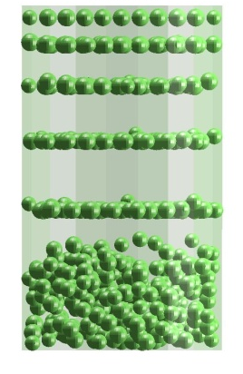
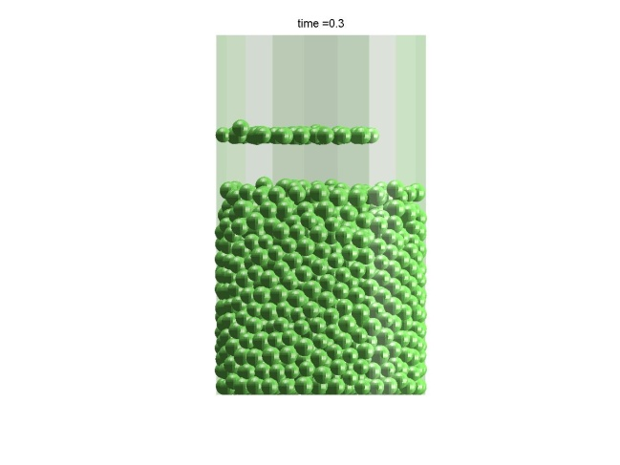
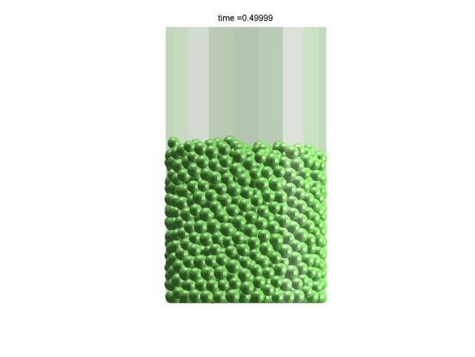
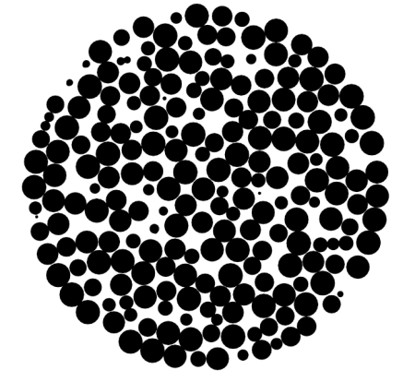
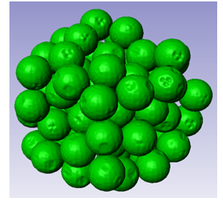
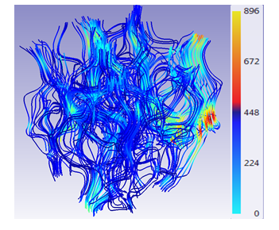
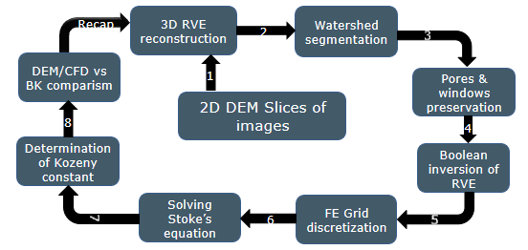
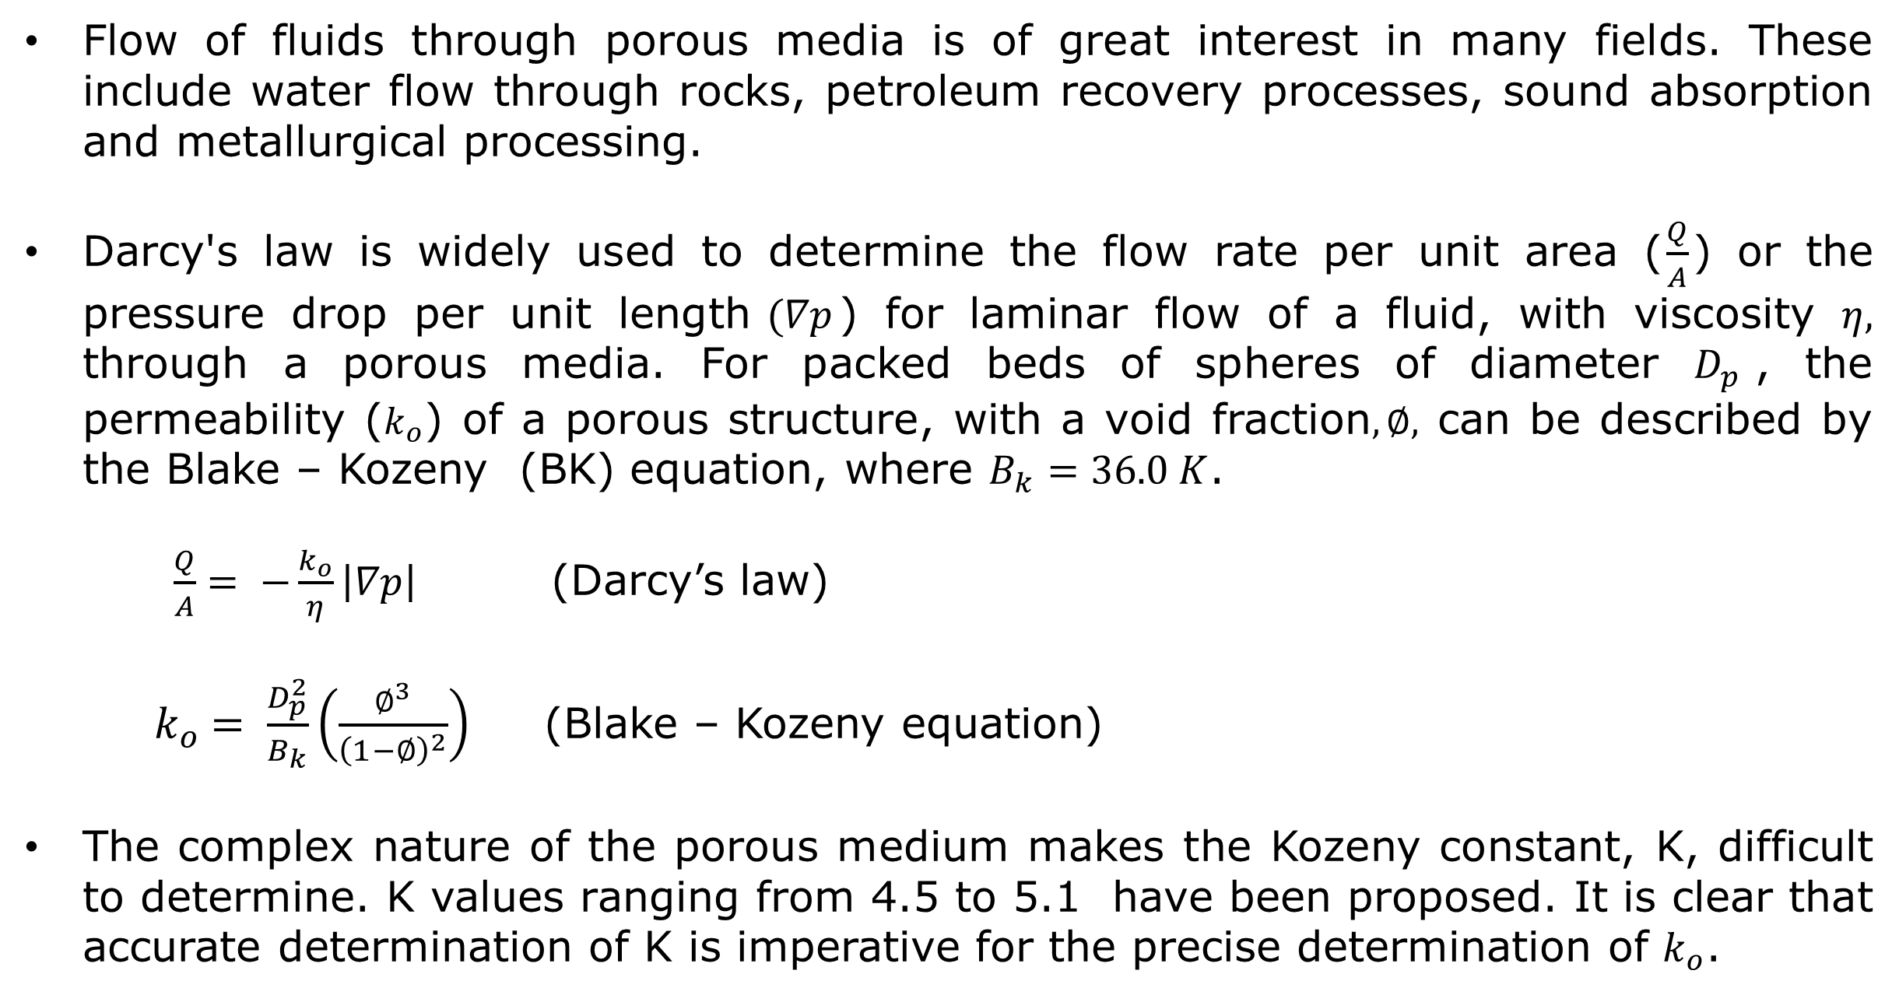
Microscale Simulation of Single Phase Flow in Porous Media: Comparison with the Blake - Kozeny equation.
www.nottingham.ac.uk
Otaru, A.J., Kennedy, A.R. & Morvan, H.P.
Department of Mechanical, Materials and Manufacturing Engineering, University of Nottingham, Nottingham,
NG7 2RD, United Kingdom.
Email:eaxao@nottingham.ac.uk
1. Introduction
3. Results
Flow of fluids through porous media is of great interest in many fields. These include water flow through rocks, petroleum recovery processes, sound absorption and metallurgical processing.
Darcy's law is widely used to determine the flow rate per unit area ($\frac{Q}{A}$) or the pressure drop per unit length$(∇p$) for laminar flow of a fluid, with viscosity $η,$ through a porous media. For packed beds of spheres of diameter $D_{p}$, the permeability ($k_{o}$) of a porous structure, with a void fraction$, ∅,$ can be described by the Blake – Kozeny (BK) equation, where $B_{k}=36.0 K$.
$\frac{Q}{A}= −\frac{k_{o}}{η}\left|∇p\right|$ (Darcy’s law)
${ k}_{o} = \frac{D_{p}^{2}}{B_{k}}\left(\frac{∅^{3}}{{\left(1−∅\right)}^{2}}\right)$ (Blake – Kozeny equation)
The complex nature of the porous medium makes the Kozeny constant, K, difficult to determine. K values ranging from 4.5 to 5.1 have been proposed. It is clear that accurate determination of K is imperative for the precise determination of $k_{o}$.
Figure 6 plots DEM/CFD modelled data (points) and Blake Kozeny predictions (lines) for the absolute permeability vs void fraction.
The modelled values agree reasonably well with that obtained from the BK model, within the range of K values reported in the literature, especially for smaller particle sizes.
2. Research Approach
Figure 6: Plot of absolute permeability vs fluid volume fraction.
Numerical modelling of the permeability of packed beds of spheres has been performed using the Discrete Element Method (DEM) and CFD. Simulations have been compared with predictions from the Blake - Kozeny equation.
DEM was used to create randomly-packed beds of spheres (ranging from 1-3 mm in diameter) using variable inter-particle friction to control the packing density. Particle position and size data were then processed using MatlabTM to create 2D slices (as shown in Figures 1 and 2).
4. Kozeny constant
Table 1: Model and BK permeability data.
Average Particle Size (mm) | Volume Fraction | Model Permeability / 10⁻⁰⁹ m² | K from BK model | Permeability / 10⁻⁰⁹m² @ K = 4.832
1 | 0.330 | 0.509 | 4.556 | 0.480
1 | 0.368 | 0.699 | 5.186 | 0.750
1 | 0.392 | 0.911 | 5.159 | 0.973
1 | 0.454 | 1.970 | 4.599 | 1.875
2 | 0.337 | 2.000 | 5.008 | 2.073
2 | 0.340 | 2.210 | 4.726 | 2.161
2 | 0.395 | 3.940 | 4.930 | 4.020
2 | 0.429 | 6.370 | 4.400 | 5.801
3 | 0.336 | 4.570 | 4.880 | 4.615
3 | 0.341 | 4.820 | 4.948 | 4.936
3 | 0.377 | 7.850 | 4.559 | 7.406
3 | 0.439 | 14.400 | 4.846 | 14.443
Table 1 shows the K value required in the BK model to most accurately fit the model values.
It also shows the permeability predicted by the BK model using an optimum value of K = 4.832, determined using Lagrangian interpolation.
The plot in Figure 7 compares the modelled permeability and that determined by the BK model using the optimum value of K (4.832)
The agreement is very good for the range of particle sizes and void fractions investigated in this study.
Figure 1: DEM simulation of the filling of a 35mm
diameter vessel with monosized beads
Figure 2: 2D horizontal slice after processing in MatlabTM
SimplewareTM was used to import 2D slices and mesh the inter-particle spaces for simulation of the flow. The Navier-Stokes equation with an impermeable side wall boundary condition was solved in the +FLOW module of SimplewareTM and the permeability in the height, Z, direction was determined. A representative volume (RVE) of spherical, packed beads and the fluid phase velocity streamlines are shown in Figures 3 & 4 below. The steps involved in the simulation process are also shown below in Figure 5.
Figure 3: Spherical packed beads
Figure 4: Fluid velocity streamline plot.
Figure 7: Modelled permeability vs BK permeability.
5. Conclusions
DEM has been used to create randomly-packed beds of monosized spherical beads with different packing fractions. DEM data have been used to create 3D volumes for simulation of 1D laminar flow using Simpleware software combined with a flow solver.
For sphere diameters in the range of 1-3 mm and void fractions in the range of 0.3-0.5, agreement between the permeabilities of modelled structures and predictions from the Blake –Kozeny model are good when the Kozeny constant, K, is 4.832.
Figure 5: Schematic of the simulation process
AO would like to acknowledge the University of Nottingham for the Dean of Engineering Research Scholarship for International Excellence and Simpleware Ltd for the provision of the +FLOW solver and technical support.
Research Group: Thermo and Fluid Mechanics
Research Division: Energy and Sustainability

