Slide 1

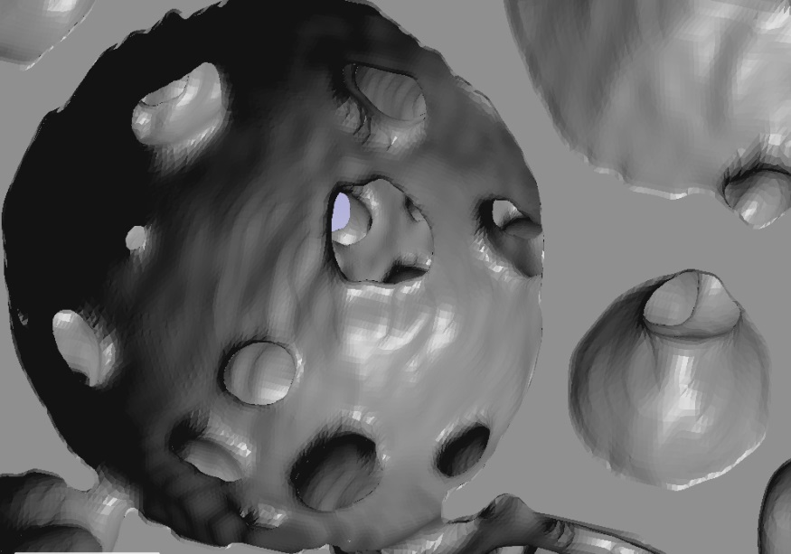
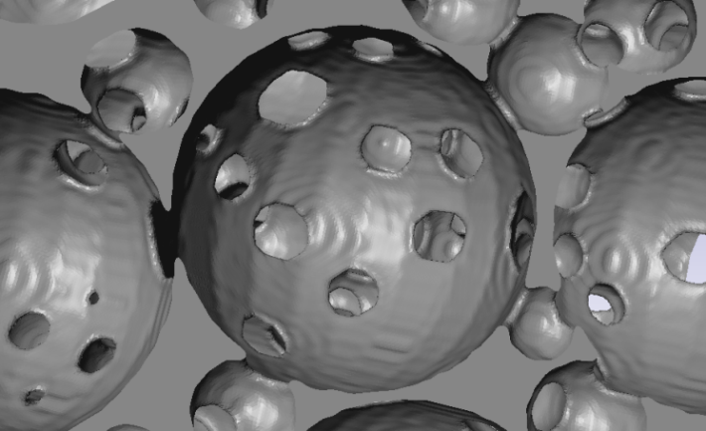
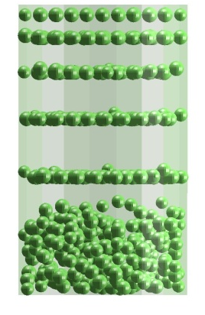
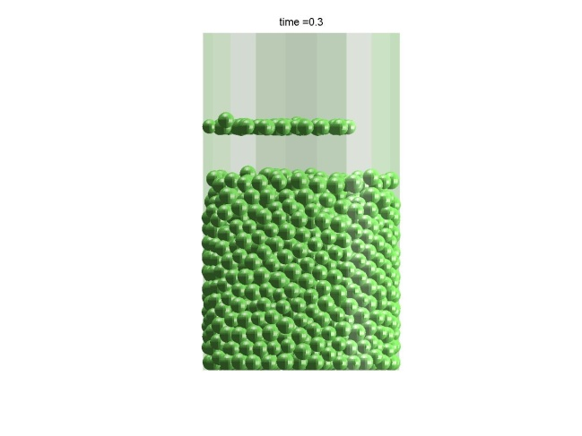
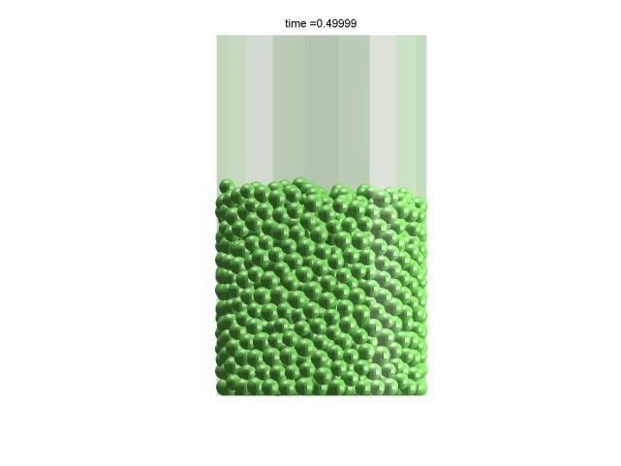
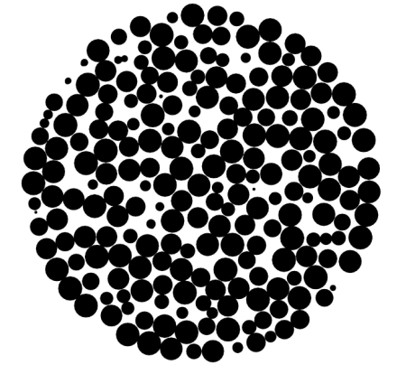
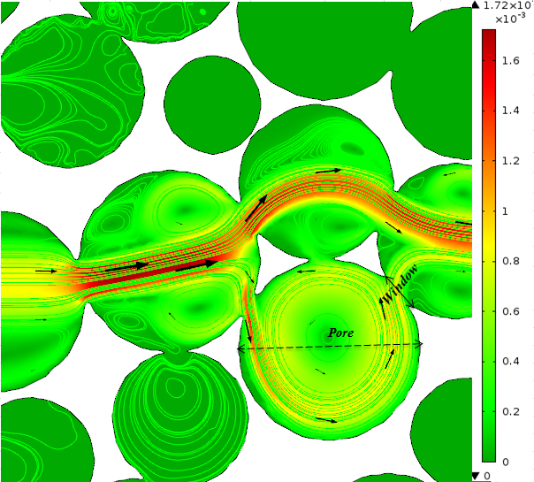
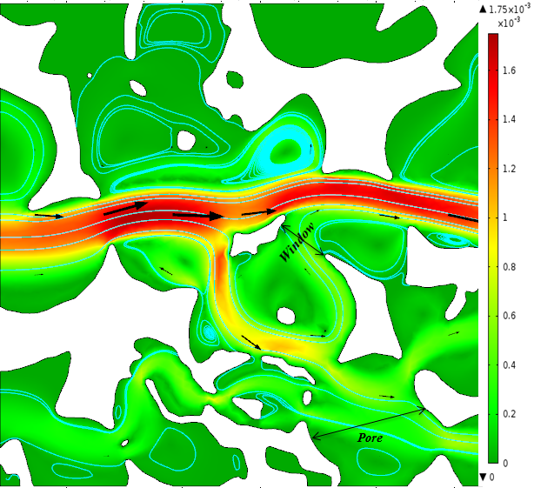
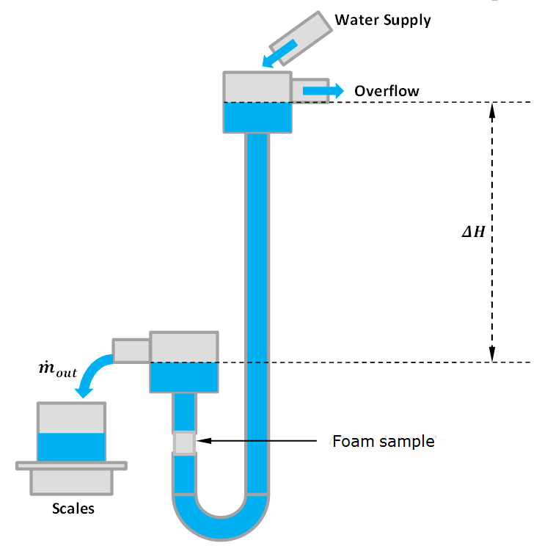
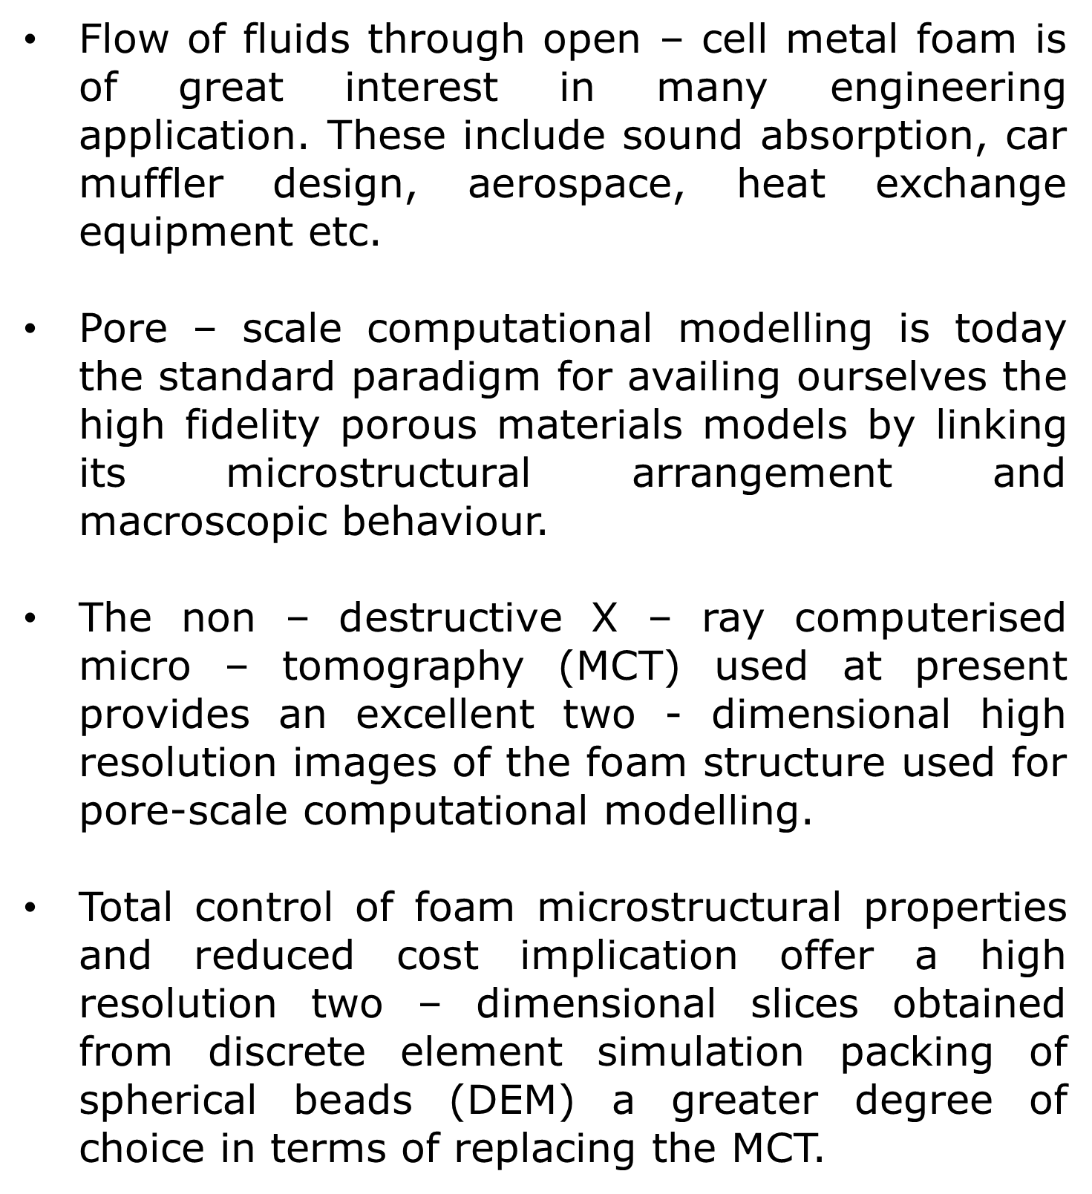
Discrete Element Modelling and Micro-Computed Pore-Scale Hydrodynamic Behaviour of Open-Cell Foams
www.nottingham.ac.uk
Otaru, A.J., Kennedy, A.R. & Morvan, H.P.
Department of Mechanical, Materials and Manufacturing Engineering, University of Nottingham, Nottingham,
NG7 2RD, United Kingdom.
Email:eaxao@nottingham.ac.uk
1. Introduction
3. MCT and DEM comparison
Flow of fluids through open – cell metal foam is of great interest in many engineering application. These include sound absorption, car muffler design, aerospace, heat exchange equipment etc.
Pore – scale computational modelling is today the standard paradigm for availing ourselves the high fidelity porous materials models by linking its microstructural arrangement and macroscopic behaviour.
The non – destructive X – ray computerised micro – tomography (MCT) used at present provides an excellent two - dimensional high resolution images of the foam structure used for pore-scale computational modelling.
Total control of foam microstructural properties and reduced cost implication offer a high resolution two – dimensional slices obtained from discrete element simulation packing of spherical beads (DEM) a greater degree of choice in terms of replacing the MCT.
Figure 7 plots micro - CT computed, MTU (L-L) and DEM/CFD reduced pressure drop data against superficial velocity for varying degree of capillary radius (5.0 – 80um).
Within the range of pre-defined superficial velocity, The MTU (L-L) CFD computations agree reasonably well with DEM/CFD modelled data for a capillary radius of 20 – 30um with an approximate value of 7% (permeability) tolerance for a 1 bar infiltrated pressured foam (MTU) and DEM/DU2A (L-L) rc = 20um.
Figure 1: Metal sponge (MCT)
Figure 2: Metal sponge (DEM)
Figure 7: Reduced pressure drop (10⁶*Pa.s/m²)against superficial velocity (mm/s) for
DEM mono-sized (L-L) at rc = 5-80um
2. Research Approach
4. Experimental validation
DEM was used to create randomly-packed beds of spheres (1.4 – 2.0mm and 2.0 – 2.5mm) using variable inter-particle friction to control the packing density, sizes and connectivity. Particle position and size data were then processed using MatlabTM to create 2D slices (as shown in Figures 3 and 4).
X-ray computerised micro – tomography scanner was used to provide a high resolution two – dimensional images of foam structures produced by infiltrating liquid aluminium (molten) into packed spherically shaped salt beads (NU spherical foam - G; 1.4 – 2.0mm) and pseudo-spherical hydro-soft packed salt (hydrosoft - foam - C; 2.0 – 2.5mm) beads at an infiltration pressure of ½ and 1 bar respectively.
SimplewareTM was used to import 2D slices and mesh the inter-particle spaces for simulation of the flow. The low velocity (Laminar flow) Navier-Stokes equation with velocity inlet, zero pressure outlet, symmetrical sides and internal wall boundary condition were solved in +FLOW module of SimplewareTM and COMSOL MultiphysicsTM.
A constant head permeameter was built to measure a discharge velocity (V) of water against a constant head (ΔH) for the laminar flow of fluid through the cross – section of a fitted foam matrix in a pipework as shown in Figure 5.
Figure 8 shows measured and CFD modelled pressure drop per unit length (Pa/m) against superficial velocity (mm/s) for the two foam structures.
The low inflow velocity of fluid against a fixated head loss recorded for NU spherical foam – G is an indication of low contacts (coordination number) between connecting pores compared to the hydro-soft foam – C.
Tolerable agreement between values obtained from the two pore-scale techniques and experimental data.
Figure 3: DEM simulation of the filling of a 35mm
diameter vessel with monosized beads
Figure 4: 2D horizontal slice after
processing in MatlabTM
Figure 8: Measured and CFD pressure drop per unit length
(Pa/m) against superficial velocity (mm/s).
DEM
MCT
k₀, NU spherical =1.390*10⁻⁰⁹m²
Figure 9: Two – dimensional velocity profile plots of DEM and MCT computation.
5. Conclusions
DEM data and X – ray micro – CT scanner have been used to provide a two – dimensional images of randomly-packed beds of monosized spherical beads and foam structures respectively for pore – scale laminar flow of fluid.
High-resolution MCT pore-scale computation provides a more literal description of the foam microstructural arrangement with a deviation of 2.3% (permeability) and 9.6% (Forchheimer coefficient) from reality whilst the easily and more flexible DEM structure yielded a deviation of 8.8 and 1.2% of both terms from reality.
Figure 5: A constant head permeameter
k₀, Hydrosoft =4.87*10⁻⁰⁹m²
Figure 6: SEM images of the foams
Research Group: Gas Turbine & Transmission
Research Division: Energy and Sustainability
AO would like to acknowledge the University of Nottingham for its 2014 Dean of Engineering Scholarship for International Excellence.

