Slide 1

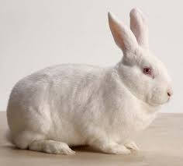
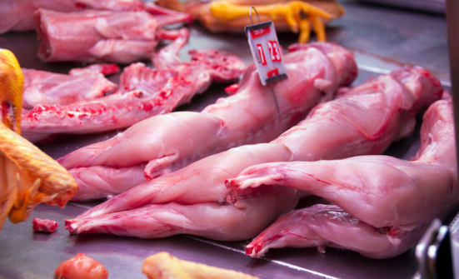
A Description of the Chemical and Physical Growth of New Zealand White Rabbits
Eniwaiye, A. A., Rani, Z. T., and Gous, R. M.
Department of Animal and Poultry Science, School of Life Sciences, University of KwaZulu-Natal, Private Bag X01, Scottsville 3209, South Africa
INTRODUCTION
OBJECTIVES
The overall acceptability of meat is dependent on the chemical and physical condition of the animal
Carcass quality changes with the animal’s age or slaughter weight
The Gompertz nonlinear regression model was employed to estimate the body growth of New Zealand white rabbit . A+C*Exp(-Exp(-B*(X-M)))
To measure the effect of sex on the physical and chemical composition of New Zealand White rabbits
To measure the changes in the physical body components weight as the rabbits grow in age
RESULTS
MATERIALS AND METHODS
Live weight increases from 175g to 2454g in the female and from 187g to 2749g in the male while the eviscerated weight increases from 135g on d- 14 to 2058g on d-140 in the female and from 146g on d-14 to 2277g on d-140 in the males.
The relationship of the growth curves is useful in understanding the changes that take place in the rabbit as it grows, and they are especially useful in predicting the weights of the various components during growth.
Farm site
Breeds of rabbits
No of rabbits
Sex of rabbits
Duration of trial
Statistical Analysis
ANOVA
Nonlinear regression analysis (Gompertz)
CONCLUSION
Table 1 | Live weight |  |  | Eviscerated weight
Age (d) | F | M | Mean | F | M | Mean
14 | 175 | 187 | 181 | 135 | 146 | 141
21 | 387 | 383 | 385 | 310 | 307 | 309
28 | 675 | 644 | 660 | 583 | 556 | 570
35 | 877 | 859 | 868 | 740 | 719 | 730
42 | 1148 | 1193 | 1170 | 928 | 983 | 955
56 | 1506 | 1461 | 1484 | 1278 | 1247 | 1262
70 | 1566 | 1513 | 1540 | 1324 | 1264 | 1294
84 | 2093 | 2132 | 2113 | 1767 | 1791 | 1779
112 | 2292 | 2393 | 2342 | 1914 | 2008 | 1961
140 | 2454 | 2749 | 2601 | 2058 | 2277 | 2167
Mean | 1317 | 1351 | 1334 | 1104 | 1130 | 1117
Table 2 | Mature weight (C) |  | Rate of maturing (B) |  | Age at maximum growth rate (M)
Item | M | F | M | F | M | F
Live | 2898 ± 115 | 2494 ± 63.8 | 0.02661 ± 0.002 | 0.03351 ± 0.002 | 44.01 ± 2.15 | 37.59 ± 1.26
Evisc. | 2383 ± 92 | 2087 ± 54.7 | 0.02762 ± 0.002 | 0.03422 ± 0.002 | 43.15 ± 2.05 | 37.54 ± 1.28
Pelt | 523 ± 36.5 | 406 ± 15.2 | 0.02135 ± 0.003 | 0.02934 ± 0.002 | 52.19 ± 2.05 | 39.00 ± 1.92
Saddle | 653 ± 45 | 545 ± 26.4 | 0.02312 ± 0.003 | 0.02913 ± 0.004 | 55.03 ± 4.07 | 46.73 ± 2.56
The data indicated a progressive increase in the live and eviscerated weight over the 140 days period.
All the physical body components of the New Zealand white rabbits have the same rate of maturation aside the live and eviscerated weights of the male and female.
The physical composition of the body systematically changes during growth, and an adequate description of potential growth dealt with such changes.

