Slide 1
Potentials of Corporate Social Responsibility for poverty eradication in Nigeria
BY
Aliyu M. Kawu & Jennifer U. Abanukam
Department of Urban and Regional Planning
Federal University of Technology, Minna 920003, Nigeria
Regions in Recovery Second Edition 2022: Re-imagining Regions 21st March – 1st April 2022, Online

Slide 2
Abstract
Corporate social responsibility (CSR) is known to keep communities and corporations, institutions, organizations and agencies that are both public and private entities in harmony and with a high sense of keeping a functional social and physical environment for the host communities. This work contends that the present practice of selecting beneficiaries, activities or development projects, and also the pace of project execution by the corporations, can hardly give rapid reduction in poverty and the total elimination of deprivations in rural and urban communities. Using secondary data and interviews of the beneficiaries, community organizations and the corporations, assessment of past activities and future plans, revealed that such endeavours can yield better outputs, with less funding, and higher-level continuity. This is as a result of the beneficiaries’ willingness for all-inclusive participatory project execution to provide and manage community facilities and infrastructure. However, for the overall outlook to community projects’ execution, financing and management; governments and urban authorities has many yet unique roles and ways that sees the different urban socioeconomic settings from differing dimensions. The present global realities have popularised inputs and partnership by the authorities as the main guiding pillar of success in increasing number of ways – one of which is to co-produce, in area specific circumstances, even for projects that corporations can and have been known to carry out successfully.
KEYWORDS: CSR, infrastructure finance, community participation, project beneficiaries, urban management

Slide 3
INTRODUCTION
Corporate Social Responsibility (CSR) – having growing interest
Goes beyond primary functions of corporations – tackle poverty, inequality, environmental degradation and climate change
CSR – ‘’the commitment of businesses to contribute to sustainable economic development by working with employees, their families, the local community and society at large to improve their lives in ways that are good for business and for development’’ (WorldBank, 2002).
(Blowfield & Frynas, 2005:503) “firms are responsible for their impact on society and the natural environment, sometimes beyond legal compliance and the liability of individuals”.

Slide 4
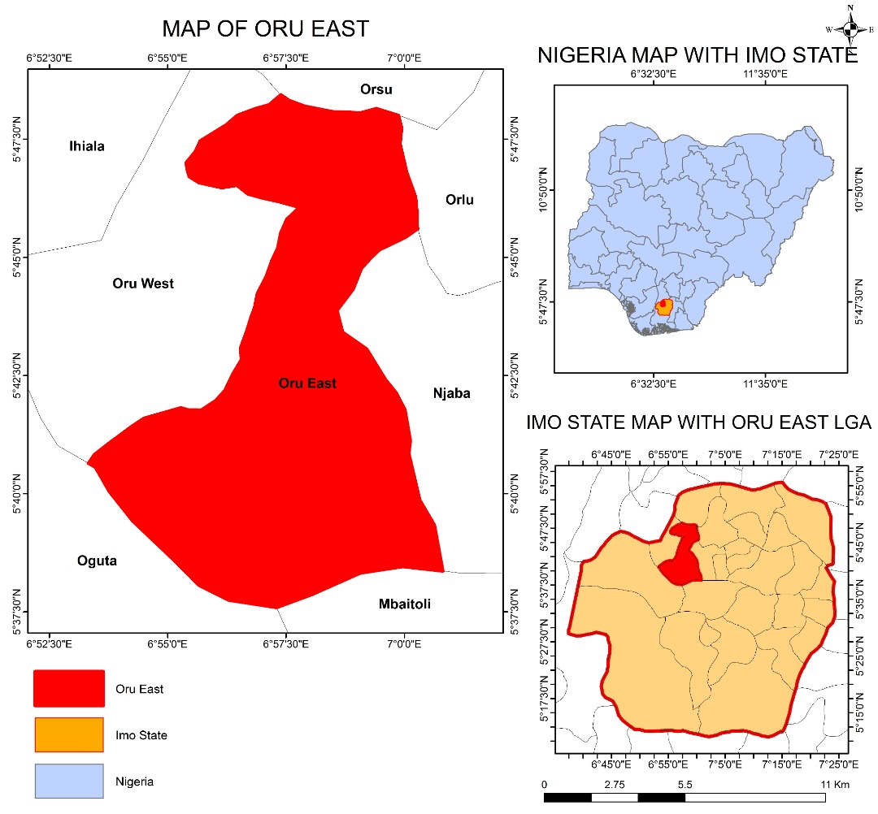
The Study Area

Slide 5
In Nigeria CSR initiatives are ad hoc and not always sustained
But, need to be more proactive
  Job creation, productivity, and improving the quality of life
  Socially responsible, by investing in the corporate and social development of Nigeria…” (Nigerian National Planning Commission 2004).
CSR in Nigeria can be traced back to the CSR practices in the oil and gas multinationals.
In remedying the effects of their operation activities

Slide 6
Aim and Objectives
This work is an assessment of the impact of Corporate Social Responsibility as an effective tool for poverty alleviation using Oru-East LGA of Imo State, Nigeria.
Assess the: socio-economic characteristics of the study area; various dimensions and natures of CSR; and, the impacts of CSR on social and environmental development
Examine the hindrances, challenges, and, the opportunities of CSR

Slide 7
Conceptual CSR
For the general purpose of this study, the CSP for the poor is of interest as part of society and a firm's stakeholders, that is, those who affect or are affected by the achievement of the firm's objectives, such as employees, customers, suppliers, community and the natural environment (Clarkson, 1995; Freeman, 1984).
CSR plans must be coherent with the needs and ethical values of every culture. Not to import unfamiliar versions of CSR
Local managers may be trapped between their parent company’s mandate and the expectations and claims of their local stakeholders (Blowfield and Frynas, 2005)

Slide 8
Methods and Data
Primary data
  Questionnaires
  Observations
  personal interviews
Secondary data
  Records from the corporations
  Records from the respondents’ groups
  Published and unpublished materials
Data analysis - descriptive and inferential statistics

Slide 9
Economic characteristics
Largely agrarian settlements
Mainly rural populations
Scattered settlements – 41 communities
Engaged in rural economic activities
Less access to facilities like: electricity, water supply, secondary healthcare, higher education
Many corporation has had to call on prospective beneficiaries to participate

Slide 10
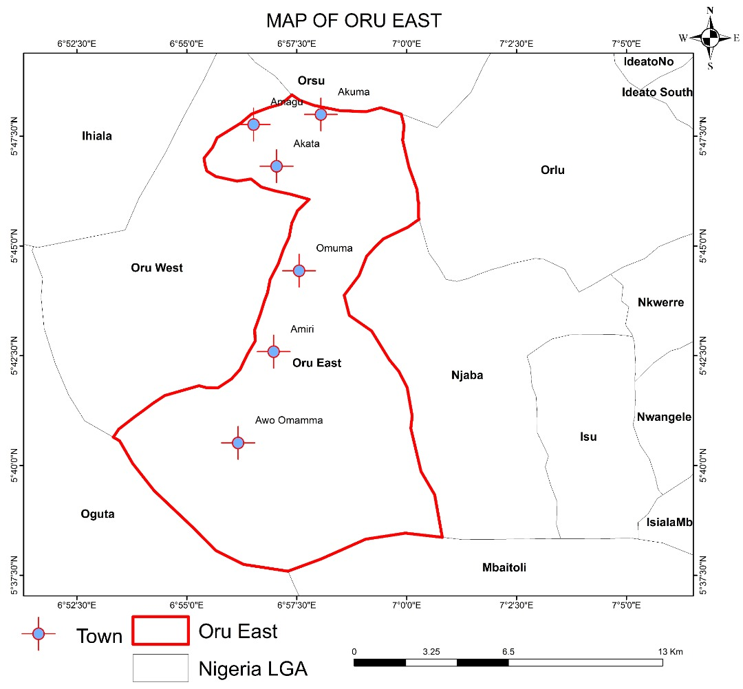
Major Towns in Oru-East LGA

Slide 11
CSR Activities
Uncoordinated
Mainly in socio-economic sectors
Less on the environment and infrastructure
The settlements are lacking in livelihood infrastructure
Many areas are not attended to
  Leisure and tourism
  Only Vigilante to provide neighbourhood security
  No tertiary education and health facilities

Slide 12
CSR activities

Slide 13
CSR Provision of facilities

Slide 14
Challenges
Non-coordination of activities of the corporate organizations
Non-involvement of the direct beneficiaries
Paucity of guidelines at local and regional levels
Corporations lack specific plan for CSR
Non-encouragement from government and stakeholders
Lack of societal awareness
Lack of data in the right format often stiffen diligent planning

Slide 15
Opportunities
Strategic plan by the corporations
Awareness by the communities and prospective beneficiaries
Government to be more focused on issues of CSR
CSR be Statutory regulation to be enforced even in rural areas
At the national level, the federal government should enforce CSR as in other related issues like the Education Trust Fund (ETF) whose existence has given life to education.
Another veritable source for urban and regional development

Slide 16
THANK YOU
FOR
YOUR TIME & ATTENTION

