Slide 1
Energy resources of Southern Africa: Potentials, governance and sustainable energy delivery
Paper Presented at the International Conference on:
Navigating Complex Pluriversal Relations: Indigeneity, Natural Resources Governance and Intercontinental Relations in the 21st century, 5-7 July, 2022, University of Pretoria
Prof. Yekeen A. Sanusi (PhD)¹, Dr Bernard C. Ohadugha¹, Dr Valda . Martins¹ and Sheriffdeen A. Olaide¹
¹Department of Urban and Regional Planning,
Federal University of Technology, Minna. Nigeria.
Correspondent author: Yekeen A. Sanusi; Email: yasanusi2@gmail.com

Slide 2
Outline
Introduction: resources, energy resources; energy challenges; objectives
Energy resources and Energy Governance
Methodology
Results:
  Energy Status
  Energy Potentials
  Energy Governance Action
Conclusion
Recommendations

Slide 3
Introduction: Natural resources
Materials in the environment naturally formed and valuable for use by human beings.
Constitute a significant part of the national wealth of most nations
They are (1) part of the environment (2) formed naturally and (3) are useful to man.
Occur in varying forms and volumes across space.
Provide support ecological services for both the human society and the environment.

Slide 4
Introduction: Natural resources
Occur in single form or in complex, and separated through human technologies.
Classified as renewable or non renewable resources.
Contribute to sustainability. Sustainable development:
‘Sustainable development seeks to meet the needs and aspirations of the present without compromising the ability to meet those of the future’ (Brundtland Commission, 1987)
‘a systems approach that incorporates environment, economy and society; (Rajovic and Bulatovic, 2017).

Slide 5
Energy resources
Challenges facing energy resources in Southern Africa:
Meaning
Energy resources are part of the natural resources available to man.
Energy resources serve three broad functions.
  Serve as exportable commodity to nations and
  they provide direct use to the nations for developing energy output that provide a range of services to the people.
  Intangible advantages: consisting of national pride, confidence and enhanced international diplomacy.
Underdevelopment of these resources resulting in:
Low energy generation capacity
low per capita energy consumption and
High level of deprivation in energy services

Slide 6
Paper Objectives
examine the present status of energy consumption,
explore the energy potentials of Southern Africa and
understand the governance activities pursued to resolve the energy challenges.

Slide 7
Energy Resources and Energy Governance
Energy resource development is influenced by quality of governance
Governance
  is about stewardship of formal and informal rules of political system
  Measures of setting rules and their enforcement
  Negotiation of interest and resolution of conflicts
  Service delivery
  Effective use of institutional mechanisms to effect positive changes
  Getting political machinery to work

Slide 8
Energy governance
Purpose
Meaning
Persistent energy poverty,
corruption in the management of fossil fuel resources,
threats to global energy supply,
increasing players in the energy sector
the task of energy transition
the increasingly complex nature of the energy market.
pressure of increased energy demand
agitations for fair deal by the prospective consumers, and
the increasing role of non-state actors.
Energy governance is a practical response of the managers of the energy sector to the pervasive application of governance principles to all aspects of human society.
All actions and processes engaged by both state and non-state actors, participating in the delivery of the energy system, to negotiate and resolve all matters and interests concerning the energy system along its value chain.

Slide 9
Aspects of energy governance
Energy Governance
Trade
Climate Change
Energy Transition
Energy Security
investment
Source: Leal-Arcas and Filis (2013)

Slide 10
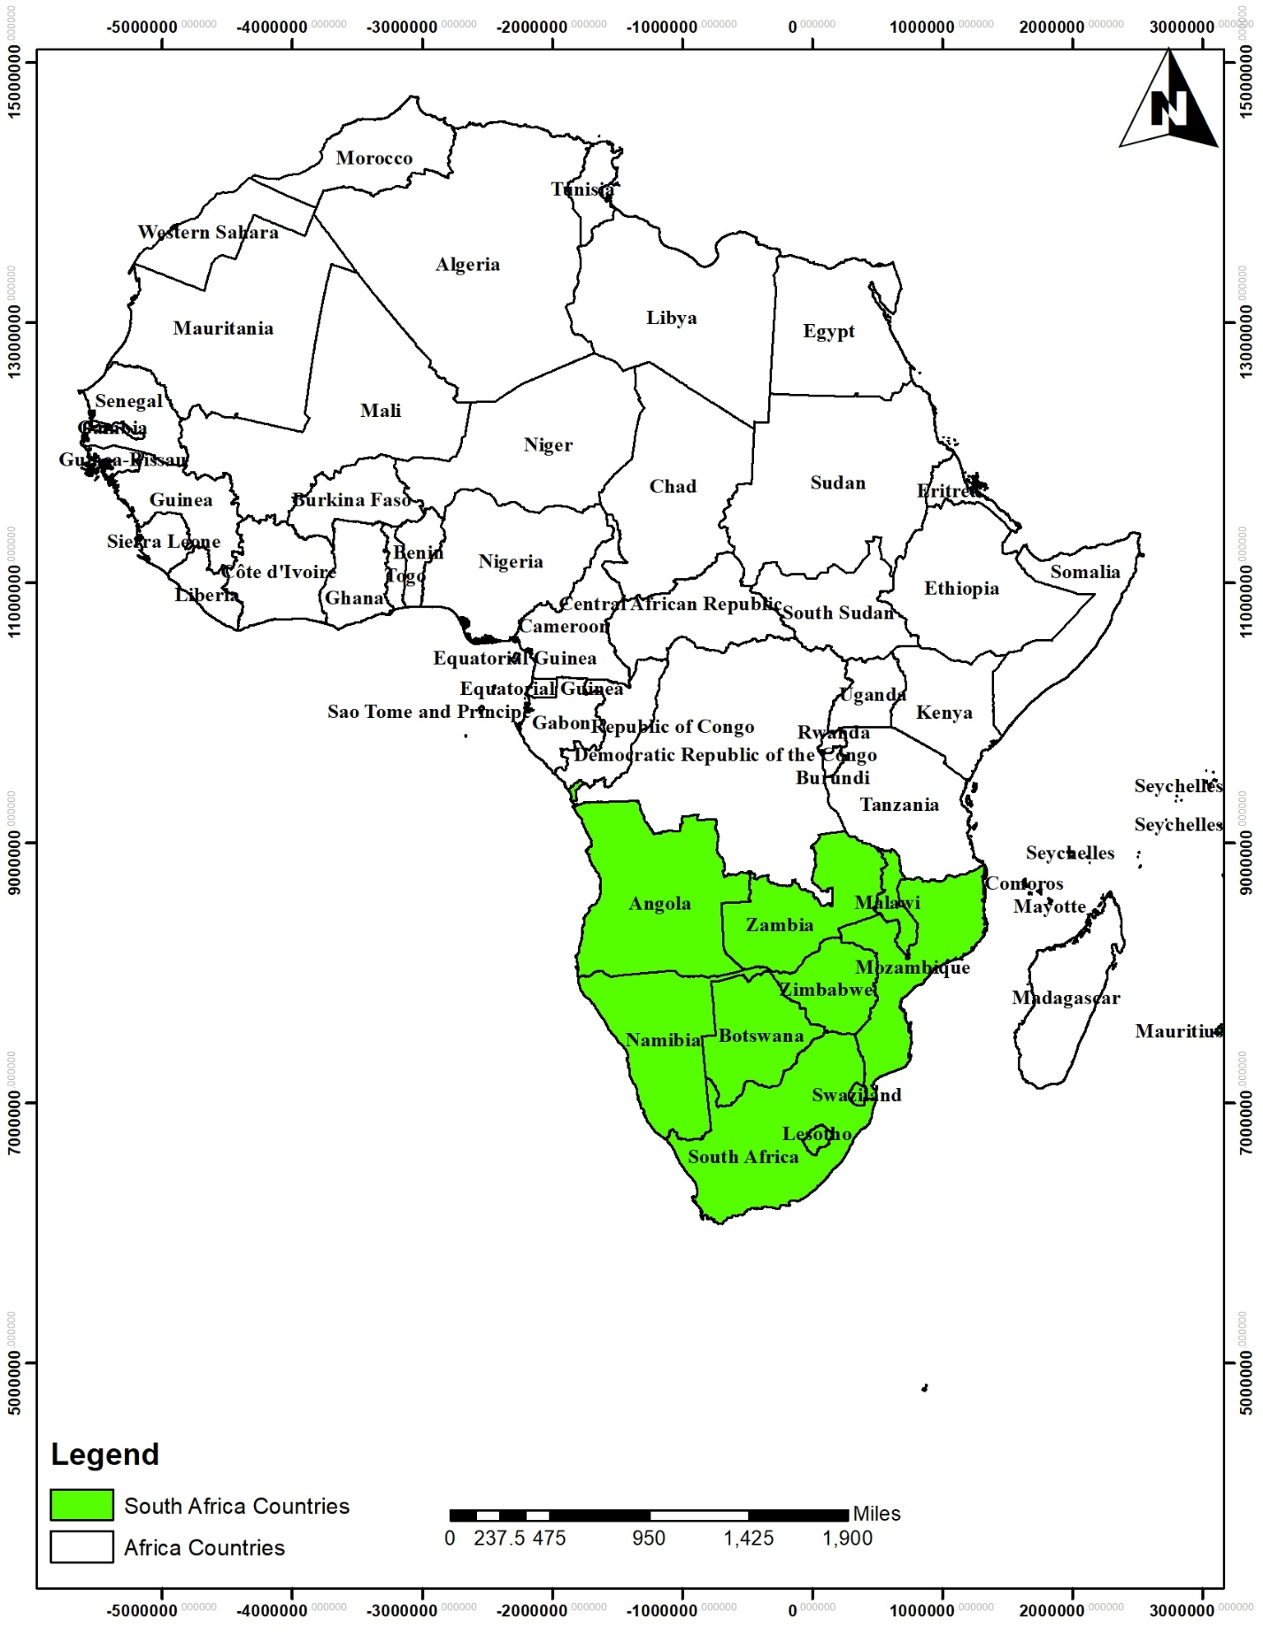
Study Area

Slide 11
Methodology: Energy potential:
Non-renewable energy resources: natural oil, natural gas, coal and uranium
Renewable resources: Wind, solar, hydropower and geothermal
Data on the non-renewable resources, hydropower and geothermal are available in the directly usable form at the country level.
Solar potential is measured by global horizontal irradiation (GHI) and practical solar potential (PVOUT): the power output achievable by a typical PV system
Wind energy potential is measured by wind density and wind speed
Data for solar energy was derived from Global Solar Atlas and that of the wind was also derived from Global Wind Atlas.

Slide 12
Methodology
Other actions considered are the independent power providers, Power Africa, Actions by the African Union and African Development Bank and the Southern African Power Pool
Data Analysis:
  Descriptive process
  comparing countries and making
  classifications.
  Some ranking was also done and leading countries in respect of each energy type identified.
Energy governance actions:
Energy policies
13 policy options categorized as renewable energy targets;(2) renewable energy in Nationally Determined Contributions; (3) Renewable energy policies and (4) Fiscal incentives and public financing.
.

Slide 13
Results: Status of Energy Access
Basic statistics of energy access
Basic statistics | Electricity consumption per capita (KWH/annum) | Energy access(total) % of population | Energy access(urban) % of population | Energy access(rural) % of population | Least Urban-rural disparity
Minimum Maximum Mean | 93.1 3539.8 1109.8 | 11.2 100 54.9 | 45.5 100 77.2 | 4.1 100 38.7 | 0 67.6 38.7

Slide 14
Results: Status of Energy Access
Three best performing countries in the energy access variables
Rank | Electricity consumption per capita (KWH/annum) | Energy access(total) % of population | Energy access(urban) % of population | Energy access(rural) % of population | Least Urban-rural disparity
1 2 3 | South Africa Mauritius Namibia | Mauritius South Africa Swaziland | Mauritius Swaziland Botswana | Mauritius South Africa Swaziland | Mauritius South Africa Sao Tome

Slide 15
Energy potential: Non-renewable energy:
Natural Gas
Natural gas reserves: Southern Africa has been least represented in Africa.
Recent discoveries:
Angola: 13.5 trillion cubic feet (tcf) (373.8 billion cubic metres)
Mozambique: 77.2tcf (2.2 trillion cubic metres).
Shale Gas
South Africa: 390tcf (11 tcm) and potential power generation of 40 854 TWh, it follows China, USA, Argentina and Mexico in that order
The non-renewable energy resources considered are natural oil, natural gas, coal and uranium. Southern African countries are not generally oil sub-region.
Natural Oil: Only Angola features among the 12 major oil countries of Africa. Angola is the fourth largest oil country in Africa, following Libya, Nigeria and Algeria. Records show that Angola has 11.6 billion barrels of oil reserves representing about 9% of Africa's total reserves of 128 bbl
New Oil discoveries: Mozambique: 120 billion barrels

Slide 16
Energy potential: Non-renewable energy:
nearest 100 tonnes.
: Reasonably assured recoverable Uranium resources 1 (January, 2019), tones U, rounded to nearest 100 tonnes.
Coal reserves in Southern Africa
Country | Reserves (million tonnes)
Botswana Malawi Mozambique South Africa Swaziland Zambia Zimbabwe | 40 2 212 30 156 200 10 502
Country | USD260/kg U
Botswana | 20400 | 3.28
Malawi | 9700 | 1.56
Namibia | 320000 | 51.42
South Africa | 258000 | 41.46
Zambia | 12800 | 2.05
Zimbabwe | 1400 | 0.22
Regional total | 622300 | 100
Source: OECD, 2020.
Source: World Energy Council, 2013

Slide 17
Energy Potential; Renewable Energy
Wind energy potential
Solar energy potential
Basic statistics | Wind density w/m² | Wind speed m/s
Minimum Maximum Mean | 97 936 375.9 | 4.65 9.26 6.98
Basic statistics | GHI (kwh/m2/year | PVOUT (kwh/kwp/year)
Minimum Maximum Mean | 1540. 2367.9 1973.11 | 1235.33 1985.05 1687.45
Source: Data from Global Wind Atlas, 2022.
Source: Data from Global Solar Atlas, 2022.

Slide 18
Energy Potential; Renewable Energy
Southern Africa large hydropower potential
region | Installed capacity (MW) | On-going construction (MW) | Current generation (GWh) | Technicall feasible potential (GWh) | Installed/ potential (%)
Southern Africa | 10 051 | 3 921 | 43 348 | 303 715 | 14.3
Africa | 32853 | 13327 | 104602 | 1546314 | 6.8
Percentage of Africa total | 30.6 | 29.4 | 41.4 | 19.6
Source: Hydropower News: https://www.andritz.com/hydro-en/hydronews/hydropower-africa/east-africa#

Slide 19
Energy Potential; Renewable Energy
Geothermal:
Two Southern African countries have geothermal resources; Zambia and Malawi.
Zambia: 2 major prospects: Kapisya with more than 80 occurrences of hot springs and Kafue which lies at the intersection of the Zambezi mobile belt.
Malawi where geothermal system is due to deep circulation along structures giving rise to medium to low temperature geothermal resources

Slide 20
Energy Governance Actions: Policies

Slide 21
Energy Governance Actions
Independent power producers (IPPs);
According to Eberhard, et al (2017), there were 92 IPPs in Southern Africa by 2017. They account for about 5.2GW of electricity.
Power Africa: An international partnership for energy development in Africa is Power Africa and an initiative of the government of USA.
By the end of 2021, nine of the 12 Southern African countries are already connected to Power Africa.
Compiled from USAID, 2022. https://www.usaid.gov/powerafrica

Slide 22
Energy Governance Actions
Continental actions: African development Bank and the African Union.
Aim: to support African countries in their efforts to provide energy for all and provide opportunities for low carbon energy development
Africa Renewable Energy initiative:
Achieve 10GW of new energy capacity at the end of 2020,
Renewable energy generation of 30GW by 2030.
New deal on Energy for Africa;
160GW new capacity by 2025;
On-grid transmission and good connections that will create 130 million new connections by 2025; Ooff-grid connections to add 75 million new connections through isolated mini-grid and standalone systems;
Access to clean cooking energy for about 150 million households by 2025

Slide 23
Energy Governance Actions
Southern Africa Regional power Pool
Formed in 1995 with member countries of Angola, Botswana, Democratic Republic of Congo (DRC) Lesotho, Madagascar, Malawi, Mauritius, Mozambique, Namibia, Seychelles, South Africa, Swaziland, Tanzania, Zambia and Zimbabwe.
Aim: to achieve a fully integrated, competitive energy market and a provider of sustainable energy solutions for the SADC region and beyond

Slide 24
Energy Governance Actions: Southern Africa Power Pool
Achievements:
Between 2011-2019: 24,488 MW new generation capacity
By 2020, the Power Pool provided 9,817 MW in excess capacity, mainly from South Africa (7,959MW) and Angola (2,261MW).
In 2020/21 operating year:
USD91.1 million was realised in total revenue that was exchanged between members;
8 205.31 GWh was traded through bilateral contracts and competitive market;
1498.55GWh was traded on the competitive market while
6707.76GWh was traded through Bilateral Contracts.

Slide 25
Conclusion:
The energy potential of the Southern African countries are enormous and offer opportunities for changing the fortunes of the energy access in these countries.
Increasing discovery of fossil fuels in the sub-region will provide opportunities for export and earning of foreign exchange and provide employment.
Problems of fossil fuel development: High level of emission; declining internationall support for fossil fuel energy development; international protest and even some local protest; the danger of other environmental hazards including resource depletion, the danger of fossil fuel trap.

Slide 26
Conclusion:
The advantages of natural gas should be recognised and hence stands useful for energy generation and domestic cooking energy use.
There is clear evidence of energy deprivation in the midst of plenty; raising the issue of resource curse.
The existing governance initiatives are many, but the tangible contributions are low.
Renewable energy option stands in very good stead to shield the Southern African countries from the largely unsustainable fossil fuels.

Slide 27
Recommendations
Sustainable energy resource development will involve:
Sound care for the environment,
People-centred energy system;
Spatial justice that recognises all places
Economic gains that involve employment generation, thriving private sector investment,
Functioning utilities,
A mix of centralised generation and distribution system and
Fulfilling international energy transition and climate change agreements.

