Slide 1
Urban Housing and Transportation Towards Zero Carbon Emission
Aliyu M Kawu
Department of Urban and Regional Planning
Federal University of Technology, Minna 920003, Nigeria
www.futminna.edu.ng aliyukawu@futminna.edu.ng, 08028597919
Notes:
Invited Paper for World Habitat Day: Accelerating Urban Action for A Carbon-free World, Niger State Geographic Information System (NIGIS) Conference Hall, Minna, Nigeria 7th October, 2021

Slide 2
Introduction
Carbon dioxide (CO₂) or Carbon monoxide (CO) is released or emitted when fossil fuel or any vegetal or animal remain is burnt or decomposed.
Emissions even during agricultural practices
Emissions increases Greenhouse gases
Greenhouse gases increases atmospheric temperatures leading to global warming
Global warming affects atmospheric, floral and fauna activities

Slide 3
Carbon and human activities
The more a city, a nation, an economy, a region, or a civilization carry out human activities that releases carbon, the more it has Carbon footprint. This can lead to:
Increasing urban heatwave
Unbearable night time temperatures
Melting of polar ice leading planetary ocean rise
Vegetal cover loss
Catastrophic forest fire bursts
Drying of lakes, rivers and water bodies
General threats to fauna and floral habitats

Slide 4
Sources of Carbon emission in urban areas
Virtually all activities that uses energy
Transport
Directly - use of fossil fuels: PMS, Diesel, Kerosine, Aviation fuel, etc.
Housing
Directly – fuel wood for cooking, heating, lighting
Indirectly – use of electronics, transport (mode & distance),
Individual household electricity generation
Hence, healthy and wealthy cities are not where most people have cars but where people use and encourage cycling and walking.

Slide 5
Questions of the day
What is the state of our urban transportation?
Does our housing system encourage zero or low carbon emission?
Is urban housing or transport system set to increase or reduce carbon footprint?
Are we aware of future implications of our carbon footprint?
Is there conscious or popular reactions?

Slide 6
Urban Transportation
The main system or process that make cities work.
Create and maintains liveable cities.
Presently a diversion from previous practices; where there is:
Encouragement of individual and small motorized modes
Conflicting of land uses
Absence or disappearance of taxes and city buses
Growing peri urban neighbourhoods
Increasing distances and transportation modes to places of work and other activities
Burgeoning cities like ours with ineffective city transport services increases carbon emission on a large scale.

Slide 7
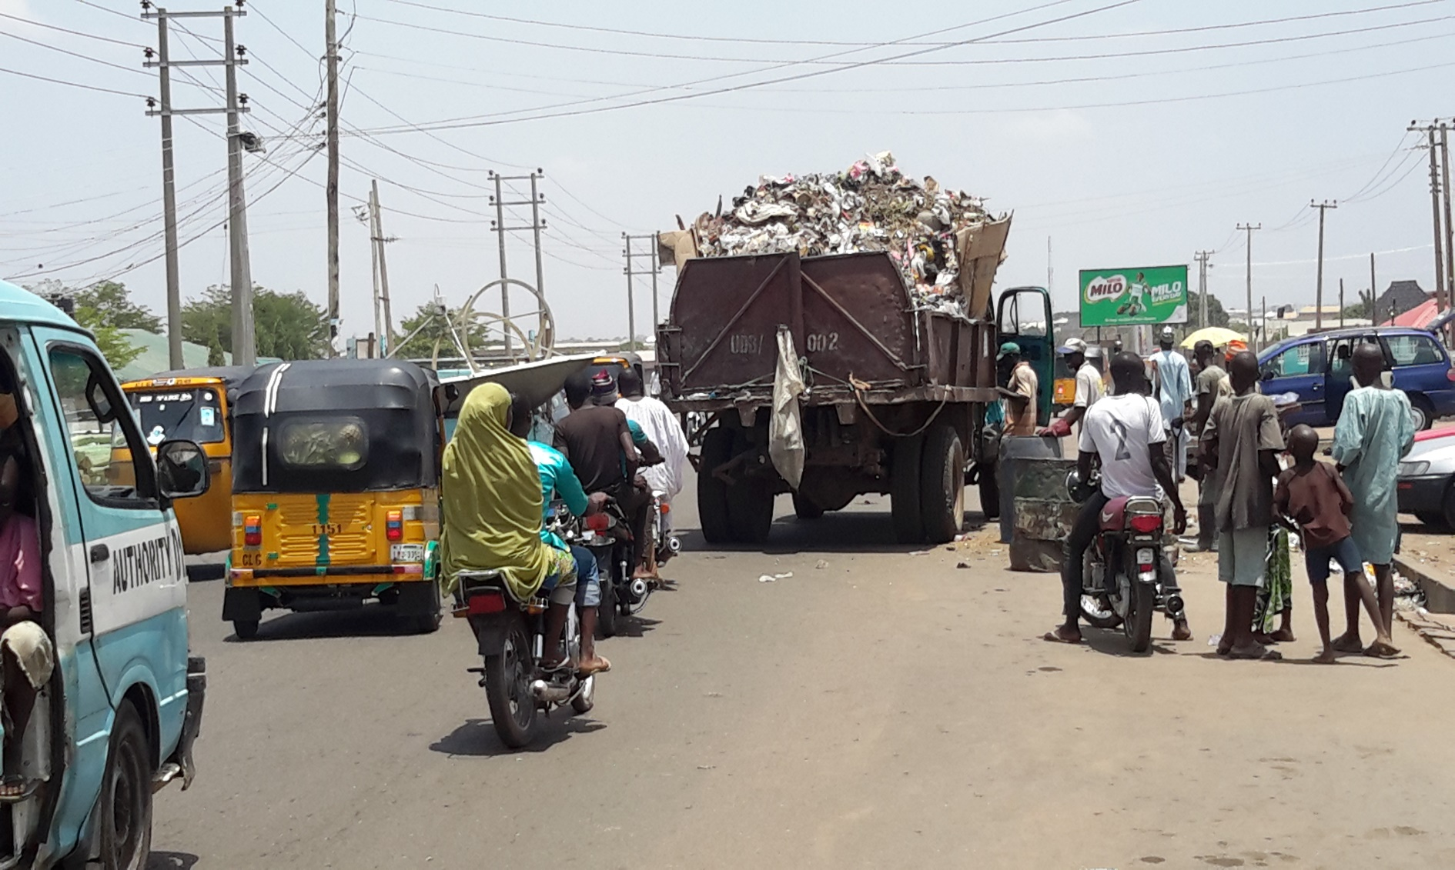
Plate I: Increasing use of motorized transportation

Slide 8
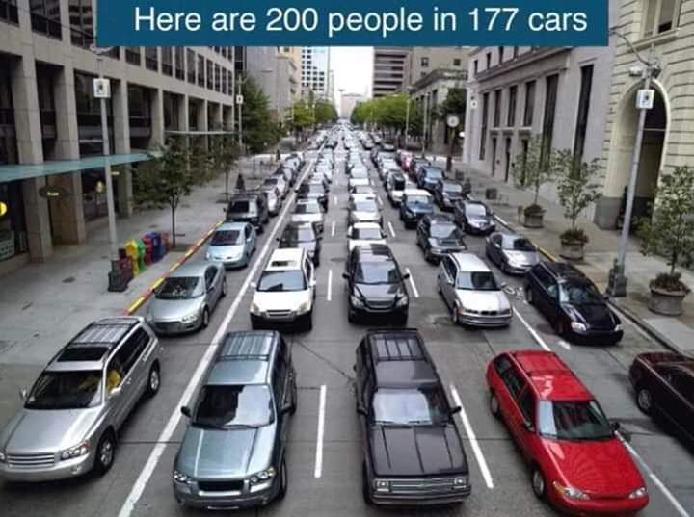
There should be a shift towards mass transit to curb carbon emission
Plate II: Individual and collective Urban transport system

Slide 9
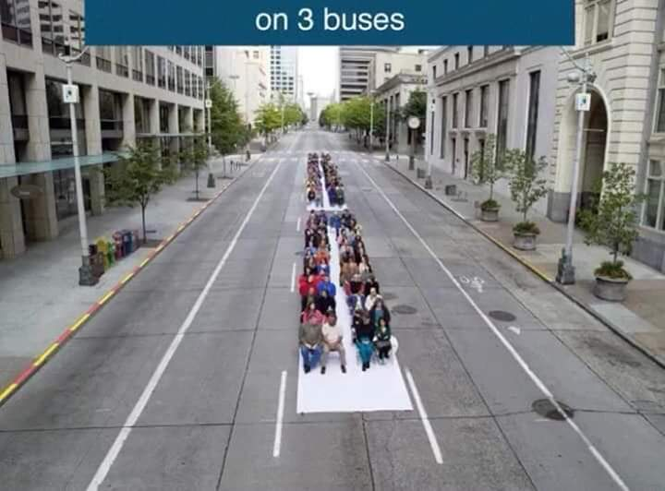
Plate III: Use of municipal transport system
The practication of efficient and reliable urban bus services comes with tremendous environmental and social benefits

Slide 10
URBAN HOUSING AND CARBON EMISSION
Housing provision (private or public) encourages serious uncontrolled urban sprawl.
Minna more than doubled in both size, structural and population density
Urban activities also increased tremendously
Failing clean energy resource generation and usage
Uncontrolled housing growth; unlike Minna before year 2000.

Slide 11
Major residential clusters are within work distances (before 2000)
GRA and Type B quarters - Government house
Railway quarters - Rail transport workers
Old Airport quarters - Old secretariat
Main city centre - Market and the CBD
Students and lecturers - On-campus
Today, city residents and workers are on their own to provide accommodation and transportation.

Slide 12
Conclusion
Housing growth means more individual motorized transportation.
Increasing motorized transport system means more and unmitigated carbon emission
Uncontrolled housing growth leads to more distance to activity areas and more carbon emission.
Little or no concerted effort to understand and mitigate carbon emission

Slide 13
Less emphasis on mitigation
Tree planting to absorb atmospheric carbon
Mass deforestation
Uncontrolled urban deforestation
Little attempt at green urbanization
Ecological footprint unmatched by correctional procedures as exhibited by the concept of handprint at city and regional levels

Slide 14
Recommendations
Need to have city buses - since there is no proper provisions for mass transits at present
Improvement on clean energy use
Subsidized renewable energy sources
Create access to city fringes to encourage effective and efficient urban bus services
Support and create people-initiated awareness programmes.

Slide 15
Create and support Green City Initiatives
Mass tree planting activities
Mandate planting of trees for residential properties to get building approval
Trees should be saved from building and construction activities
Encourage greening of urban and peri-urban areas

Slide 16
Thank you for listening

