Slide 1

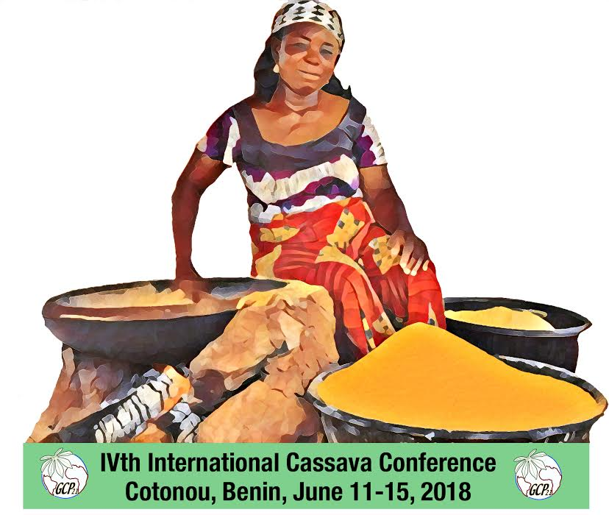
Innovations in Cassava Flour and Starch Applications: Challenges and Prospects to the Economy of Cassava Producing Countries of the World
Buliyaminu Adegbemiro Alimi
Federal University of Technology, P.M.B. 65, Minna, Nigeria
IVth International Conference on the Global Cassava Partnership for the 21st Century, Cotonou, Benin, June 11-15, 2018

Slide 2
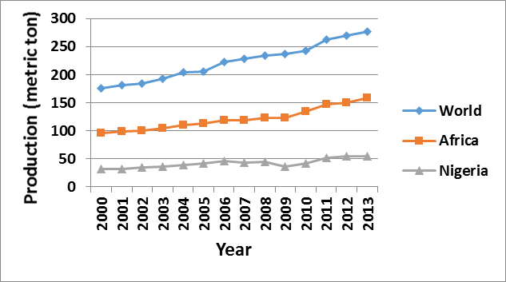
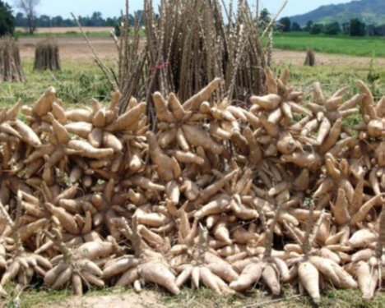
Brief Introduction of Cassava (Manihot esculenta Crants)
Mainstays of economy of some countries in Africa, Latin America and Asia
Global cassava production
Figure 1: Production of cassava roots between 2000 and 2013 (Source: FAO Statistics, 2014)

Slide 3
Nigeria is the largest producer in the world
Thailand is highest producer and exporter of cassava derived products

Slide 4
Attractive agro-ecological traits of cassava
Drought tolerance
Require low input
Year round planting/harvesting
High root productivity
High quantity/quality of starch
-Sriroth 2008

Slide 5
Intervention on cassava productivity
Improvement of high yield varieties
Improvement of agricultural practice
Supports

Slide 6
Economic importance
Strategic crop for food security and poverty alleviation
Cash and/or industrial crop for countries
Processed into several primary and secondary products to enhance its value
Its value addition depends on economical and technological advancements of each country

Slide 7
Primary processing: limited transformation of cassava tissues, mostly physical.
Secondary processing: Extensive modification of the tissues though chemical agents, microbes and enzymes
Objectives of physical processing-
Root preservation, enhanced handling and storage stability

Slide 8
Primary products
Chips
Flour
Starch

Slide 9
Cassava flour
Consumed about 45% of cassava roots in sub-Saharan Africa (Nweke, 1994)
Dry, fibrous and free-flowing
Prepared from either milled dried chips or wet mash
May be fermented or unfermented

Slide 10
Applications of cassava flour

Slide 11
High quality cassava flour (HQCF)
Non-fermented, bland, odourless, white/offwhite
Being explored in Nigeria since 1970s (Shittu et al., 2016)
Enjoys government backing in Nigeria for use as part of composite in bread baking since 2004
Extent of its inclusion affects final quality of bakery products
Optimum HQCF-wheat flour ratio for different bakery products is still being investigated

Slide 12
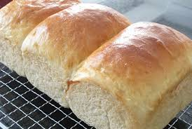
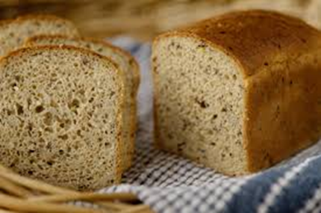

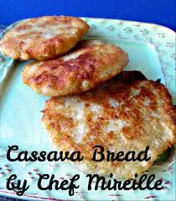
Some bakery products from HQCF

Slide 13

Syrups
Glucose syrup (GS)
Production follows 2 processes
-enzymatic and acid hydrolyses
High fructose syrup (HFS)
Produced by passing GS over columns packed with immobilized glucose isomerase

Slide 14
Syrups contd
Thailand and Vietnam have well developed technologies for production of syrups from cassava flour
Nigeria and Ghana are brazen the trail in Africa in glucose syrup production from HQCF
-Shittu et al., 2016

Slide 15
Other products for CF
Adhesives
Bioethanol

Slide 16
Cassava starch (CS)

Slide 17
Importance
Major food reserve of cassava root (≈ 21.5% of fresh cassava root) (IITA, 1990)
Major export commodity from cassava in Asia and Latin America
Control over its quality during production and storage is very important
Estimated global trade in starch by 2018 ending is $77.4 billion (BCC research, 2013)
CS share of global starch trade is 10% (FAO 2006)
Thailand alone exported $800m worth of CS in 2006 (Sriroth, 2008)

Slide 18
Current utilizations of CS

Slide 19
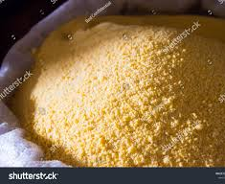
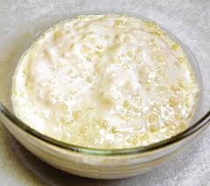
Tapioca flakes/meal
CS is roasted to form grits
Major form of consumption at household level
Widely accepted and consumed as convenient food in West Africa (Adebowale et al, 2007)

Slide 20
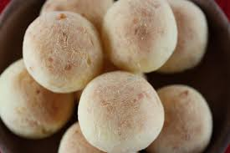

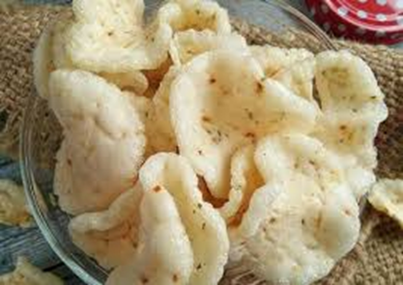
Sour starch and krupuk
Products of chemical and enzymatic modifications of native CS through fermentation
Require expansion properties specific to CS
Popular in Latin America and South East Asia

Slide 21
Industrial products from CS

Slide 22
Bioethanol
Developed due to uncertainties over future of fossil global oil reserves
Thailand and China have formulated policies for its production and uses
Use as fuel additives for octane enhancement in Thailand
There is concern over energy efficiency and prospect of producing net energy gain

Slide 23
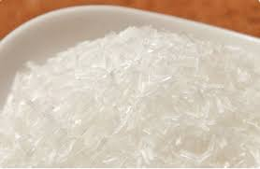
Monosodium glutamate (MSG)
Popular food enhancing agent and additive
Produced through microbial fermentation of starch in the presence of urea
Another innovative product, L-glutamic, a precursor of MSG, was produced from waste generated during large scale production of CS (Jyothi et al., 2005)

Slide 24
Other innovative utilizations of CS
Lactic acid and yeast production from CS (Wang et al., 2010)
Baking quality yeast from CS (Ejiofor, 1996)
Cationic modified starch used to enhance tensile fold and bursting strength of paper (Yang et al., 2010)
Improvement on the functionality of cationic modified CS starch for paper making (Gao et al., 2012)
Modified CS found important applications in the three areas of textile making
China textile industry relies heavily on modified CS

Slide 25
Prospective utilizations of CS

Slide 26
Starch-albumen powder
Composite CS and poultry egg-white product developed by Shittu et al., (2010)
Highly hygroscopic with type 2 sigmoid curve
Has important applications in fast food, baking and confectionery industries

Slide 27
Hydrogen gas
Potential product with great importance to energy industry
Its advantages over fossil fuel include cleanliness, higher energy density and recyclability (Das and Versiroglu 2001)
Su et al. (2009) studied the prospect of producing hydrogen gas from CS
The study concluded that there is a great potential for commercial hydrogen gas production from CS

Slide 28
Acetone-butanol-ethanol (ABE)
Produced biologically by fermentation process involving Clostridium spp under strict anaerobic condition
All the products have useful industrial applications
Further improvement of the process is the use of co-culture by Tran et al. (2010).
The later development was economical

Slide 29
Other novel utilizations of CS
Development of cardboard like composite from cassava baggase (waste) by Matsui et al. (2004)
Mushrooms (Barbosa et al., 1995)
Yeast (Ejiofor et al., 1996)

Slide 30
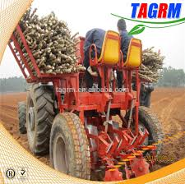
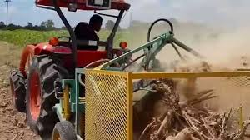
Innovative technologies
Thailand, Brazil, Vietnam and China are leading in the deployment of high end technology for the production of CS and CF and their derived products

Slide 31
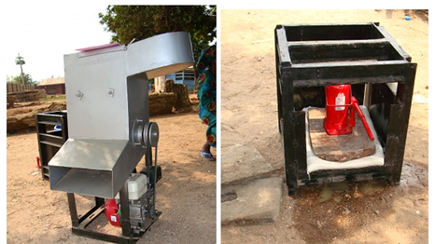
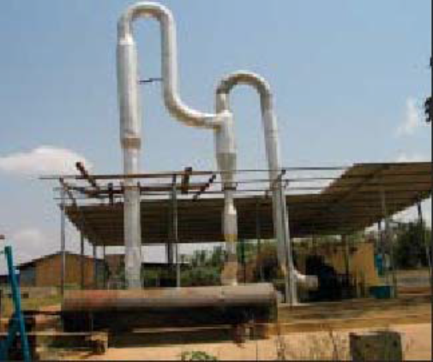
Appropriate technologies for MSME are being developed in Nigeria

Slide 32

Appropriate technologies for MSME are being developed in Nigeria

Slide 33

Gaps

Slide 34
Gaps
Most of the innovations are yet to be adopted for commercial productions
Some are still at MSME and not yet at industrial scale level
Slow adoption/transfer of innovations/technologies
Lack of well articulated market penetration strategies
Strides yet to translate to economic gains for some of the producing nations

Slide 35
Measures to ensure full benefits of research findings and technological interventions
Awareness and willingness study
Purpose improvement in the value-chain
Modeling technologies for MSME
Well designed marketing strategies
Policies and legal frameworks supports from governments
Private sector collaborations and supports
Linkages between research centers and MSME/industry for transfer of knowhow

Slide 36
Prospects
Strengthening food security of rural and urban populace
Improving competitiveness of cassava products exports
Boost cassava roots productivity
Increases employment and reduces poverty
Improves foreign earning
Reduction of trade imbalance

Slide 37
I appreciate your rapt attention

Slide 38
References
BCC research (2013) World market for starches/glucose:emphasizing cassava starch-FOD 037A. www.bccresearch.com/market research. Accessed on 28/10/2014
Das, D., & Veziroǧlu, T. N. (2001). Hydrogen production by biological processes: a survey of literature. International Journal of Hydrogen Energy, 26(1), 13-28.
Ejiofor, A. O., Chisti, Y., & Moo-Young, M. (1996). Culture of Saccharomyces cerevisiae on hydrolyzed waste cassava starch for production of baking-quality yeast. Enzyme and microbial technology, 18(7), 519-525.
FAO (2006). Starch Market adds value to cassava: spotlight/2006. www.fao.org/ag/magazine/ accessed on 25/10/2014
Gao, J., Luo, Z., Fu, X., Luo, F., & Peng, Z. (2012). Effect of enzymatic pretreatment on the synthesis and properties of phosphorylated amphoteric starch. Carbohydrate Polymers, 88(3), 917-925.
IITA. 1990. Cassava in Tropical Africa. A Reference Manual, 15–16. Ibadan: IITA.

Slide 39
Jyothi, A. N., Sasikiran, K., Nambisan, B., & Balagopalan, C. (2005). Optimisation of glutamic acid production from cassava starch factory residues using Brevibacterium divaricatum. Process Biochemistry, 40(11), 3576-3579.
Matsui, K. N., Larotonda, F. D. S., Paes, S. S., Luiz, D. B., Pires, A. T. N., & Laurindo, J. B. (2004). Cassava bagasse-Kraft paper composites: analysis of influence of impregnation with starch acetate on tensile strength and water absorption properties. Carbohydrate polymers, 55(3), 237-243.
Nweke F. I. (1994). Cassava processing in sub-Saharan Africa: the implications for expanding cassava production. Outlook on Agriculture, 23, 197-205.
Shittu, T. A., Alimi, B. A., Wahab, B., Sanni, L. O., & Abass, A. B. (2016). Cassava Flour and Starch: Processing Technology and Utilization. Tropical Roots and Tubers: Production, Processing and Technology, 415-450.
Shittu, T. A., Idowu, M. A., & Ademosun, O. O. (2010). Production of Dried Starch‐Albumen Powder: Effect of Temperature and Starch on Some Functional Properties. Journal of food processing and preservation, 34(s2), 385-400.

Slide 40
Sriroth, K. (2008). Lessons learned from the development of processing systems and markets for Thai cassava. Consultation on cassava processing, utilization and marketing, 10-13 December, 2008. Natural Resources institute, University of Greenwich, Medway, UK
Su, H., Cheng, J., Zhou, J., Song, W., & Cen, K. (2009). Improving hydrogen production from cassava starch by combination of dark and photo fermentation. International Journal of Hydrogen Energy, 34(4), 1780-1786.
Tran, H. T. M., Cheirsilp, B., Hodgson, B., & Umsakul, K. (2010). Potential use of Bacillus subtilis in a co-culture with Clostridium butylicum for acetone–butanol–ethanol production from cassava starch. Biochemical Engineering Journal, 48(2), 260-267.
Wang, Limin, Bo Zhao, Bo Liu, Chunyu Yang, Bo Yu, Qinggang Li, Cuiqing Ma, Ping Xu, and Yanhe Ma (2010). "Efficient production of l-lactic acid from cassava powder by Lactobacillus rhamnosus." Bioresource Technology 101, no. 20: 7895-7901
Yang, H. C., Zhu, W. Q., Sun, N., Zhao, Y., & Liu, X. (2009). Preliminary study on mechanisms and oil displacement performance of cationic starch. Journal of Petroleum Science and Engineering, 65, 188–192

