Slide 1
Threats to and opportunities for livelihood innovations in the face of climate change; a case study of the Savanna regions of Nigeria
Aliyu Kawu
Dept. of Urban & Regional Planning
Federal University of Technology, Minna 920003, Nigeria www.futminna.edu.ng
Notes:
International Conference Paper Planet Under Pressure: New Knowledge Towards Solutions, London 26 – 29 March, 2012: http://www.planetunderpressure2012.net/

Slide 2
ABSTRACT
Attention is not given to the various approaches and unfolding innovations adopted by local farmers to fight extreme climate phenomenon. This study examined main agricultural practices and the main employer of labour in northern Nigeria to draw attention to how local farmers i) view changing weather patterns, ii) confront these changing weather patterns in order to emphasize the recognition of opportunities and other potentials in rural and urban livelihoods of the Savanna region in Nigeria. Physical and socioeconomic surveys coupled with Focus Group Discussions (FGDs) were used to access information from farmers on farming practices between 2000 and 2010. Results shows that although weather patterns like rainfall have altered and affect soil conditions in the majority of villages, farmers have been able to develop appropriate innovations, which increase cereals output. In addition, farmers have introduced vegetable crops in areas earlier thought irredeemably lost to devastating flooding and erosion. The main recommendation here is a further acceptance of local approaches devised by the people as opportunities abound for food and cash crop production in the Savanna regions of Nigeria and beyond today than ever before.
Keywords: Africa / Climate change/ Food production/ Nigeria/ Savanna

Slide 3
Introduction
The documentation of innovative approaches by peasant farmers that feeds millions of developing countries’ bourgeoning populations are mostly left out by many assessors of climate change phenomenon, and less attention is given to site specific adaptation measures employed by farmers in Savanna and semi-arid grasslands of sub-Saharan Africa which account for over 50% of Nigeria’s land mass of over 923,000 km² (Udo, 1977).

Slide 4
Sample points
In Minna, the main areas field work was undertaken are; Gidan-kwano (Lat 9.33⁰N and Long. 6.28⁰E ), Sabon-daga (Lat 9.24⁰N and Long 6.22⁰E ), and Sabon-gida (Lat 09.24⁰N and Long 006.15⁰), those of Zaria are Hanwa Low-cost (Lat 11.07⁰N and Long 7.41⁰E) and Yan-karfe (Lat 11.07⁰N and Long 7.41⁰E), neighbourhoods of the metropolis, while Dandume (Lat 11.46⁰N and Long 7.I4⁰E ) and Nassarawa (Lat 11.46⁰N and Long 7.14⁰E) wards constituted sample areas in Funtua study area.

Slide 5
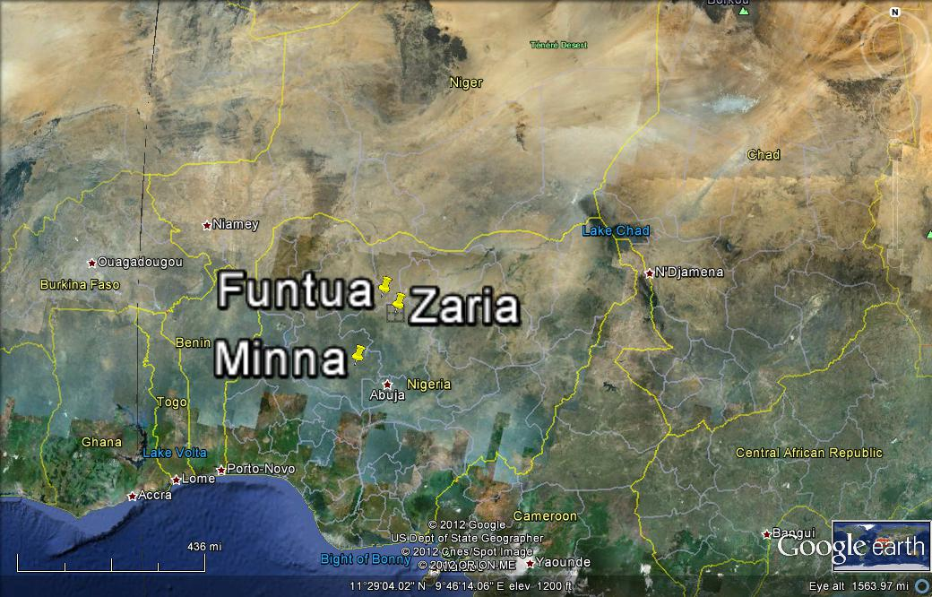
Fig. 1: The Study Areas

Slide 6
The threat of climate change
The main threat of climate and climate change related issues:
is not crop failure - due to excessive rainfall or its early cessation
but, flooding and erosion
gullying and washing away of farmlands and river banks
degrading productive lands at alarming rates
Hence the adaptation practices against these threats
to boost agricultural production and livelihood opportunities

Slide 7
Zaria - The use of borrow pits
Borrow pits came to being as a result of mineral and mostly sand mining in traditional cities of northern Nigeria, and have since raised concerns over the safety of people and livestock around them (Urquhart, 1977; Schwerdtfeger, 1980; Kawu, 2005).
Abandoned burrow pits and mine spoils at the city’s fast urbanizing peripheries are increasingly been put to innovative uses in various aspects of food production.

Slide 8
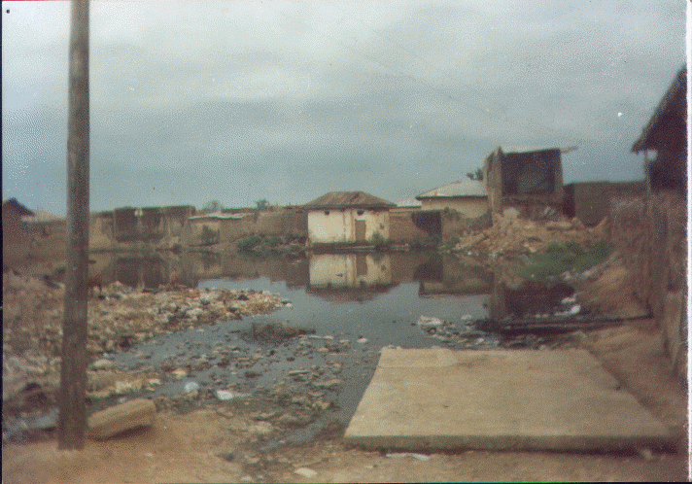
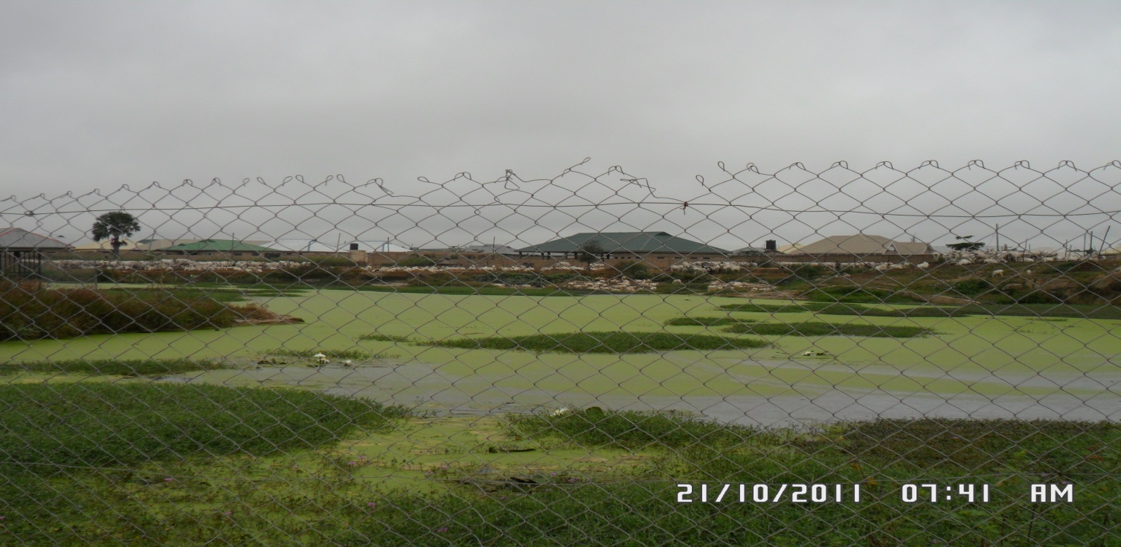
Plate II: Land Degradation, Menace of Burrowed-Pits
Plate III: A fish pond in Hanwa Low-cost, Zaria
Plate II
Plate III

Slide 9
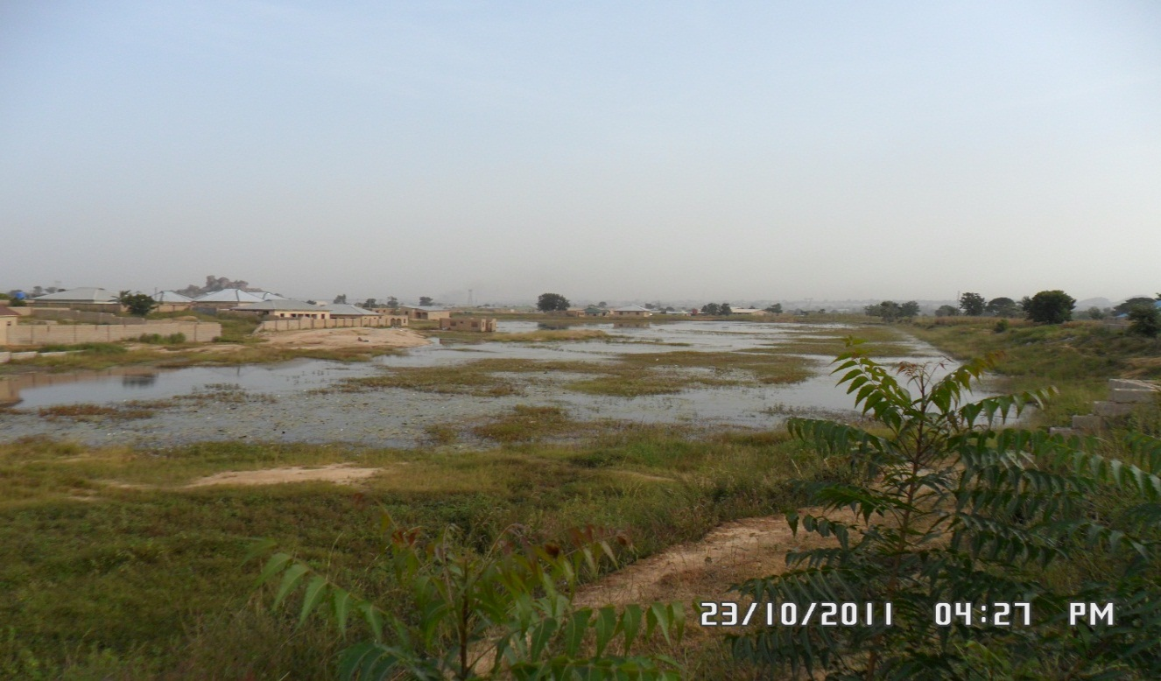
Plate IV: Stirling - A large pond serving as a water reservoir

Slide 10
Irrigation: The utilization of abandoned sand mine, Stirling, is at present drawing wider attention, in the following ways:
Supplement for rain/precipitation.
End of season farming: If rain stops, water from Stirling is used to nurture crops.
Dry-season farming: Irrigation activities is on a continuous basis.
Checking insecurity: The presence of people ensures security in these sparsely populated.
Introduction and adoption of new crops: The introduction of Irish or White potatoes (Solanum tuberosum, or Earth apple). This crop is only cultivated in Jos plateau (Lat 9.57⁰N and Long 8.53⁰E)

Slide 11
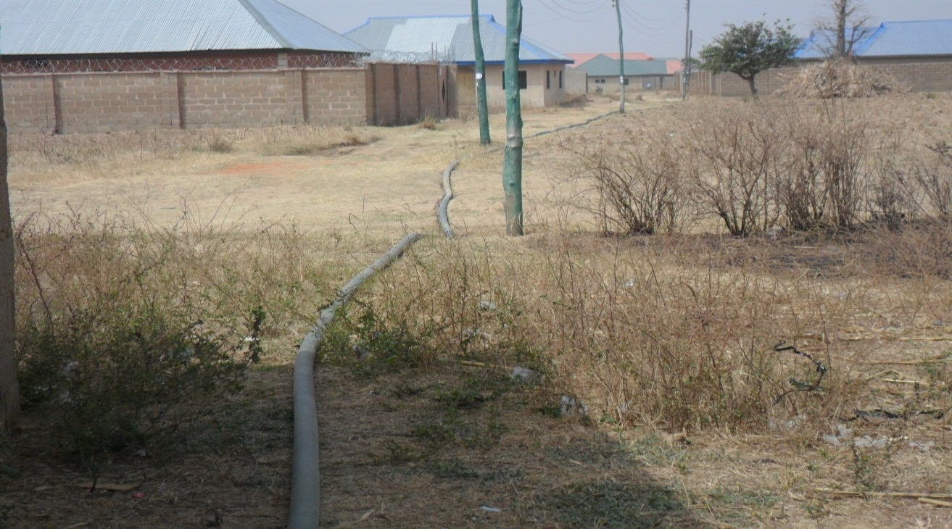
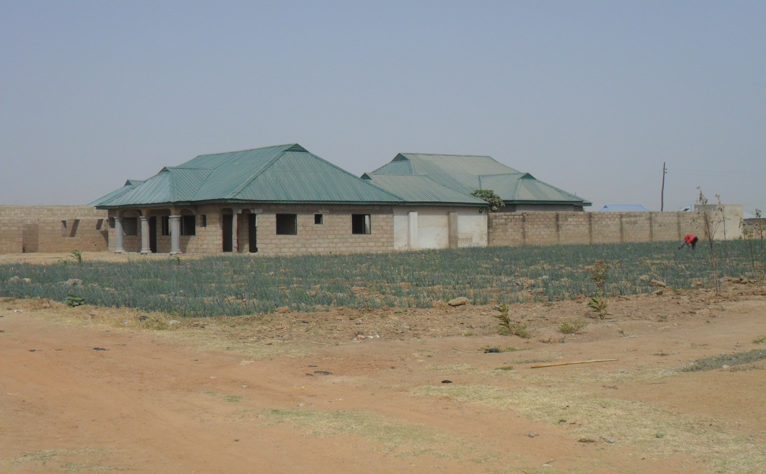
Plate V: Piping water to distant irrigation plots.
Plate VI: Tending onion farm and guiding landed properties
Plate V
Plate VI

Slide 12
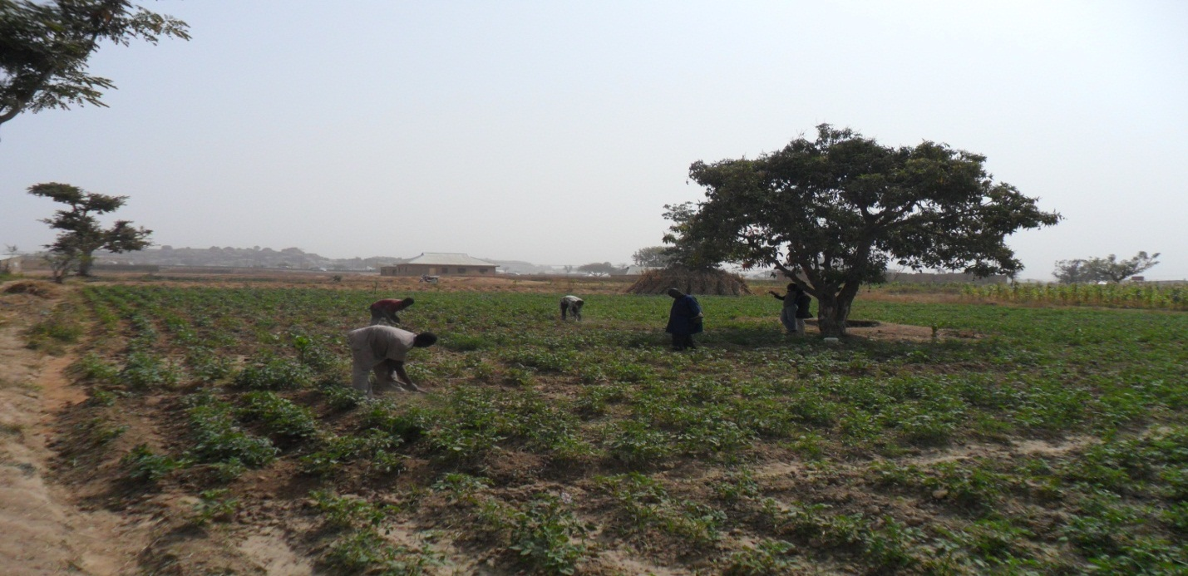
Plate VII: Cultivating Irish potatoes by irrigation in Zaria
Plate VII

Slide 13
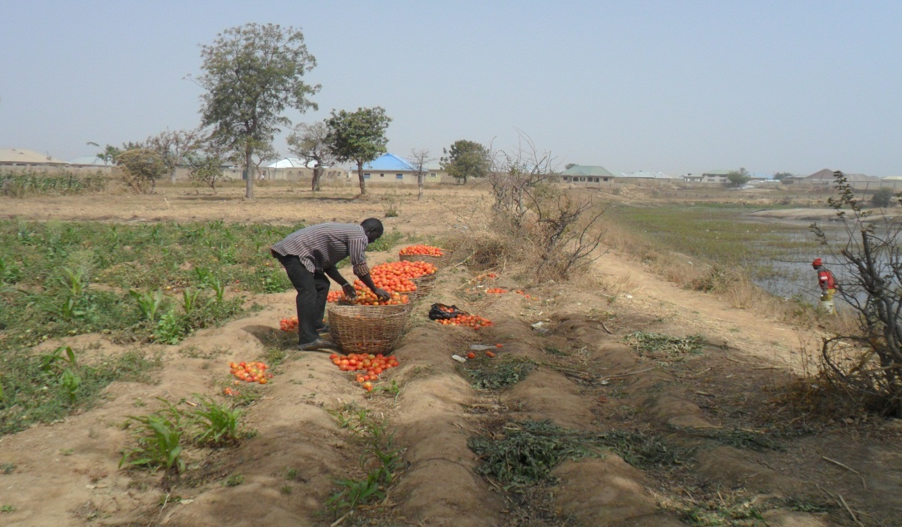
Plate VIII: Continuous multiple cultivations

Slide 14
Table 1: Frequencies of crop irrigation
Crop type | River side | Water from burrow pits
Tomatoes | 1 | 3
Irish potatoes | 0 | 2
Spinarch | 2 | 4
Onions | 1 | 3
Maize | 0 | 3
Pepper | 1 | 3
Lettuce | 1 | 4
Carrots | 1 | 3

Slide 15
Minna: Utilizing technology and increased soil moisture
Planting of additional crops: A farmer planting on a land of about 50ft by 50ft, has earned over N20,000 ($125) from the sale of paw-paw alone in one season.
Delays in the cessation of rains: is sometimes utilized by these farmers through the cultivating of vegetables or by making yam heaps and ridges reducing effects of rainfall delay.
Introduction of plantations: Rich farmers invest in innovative practices in food production and land management recovering lands lost to erosion.

Slide 16
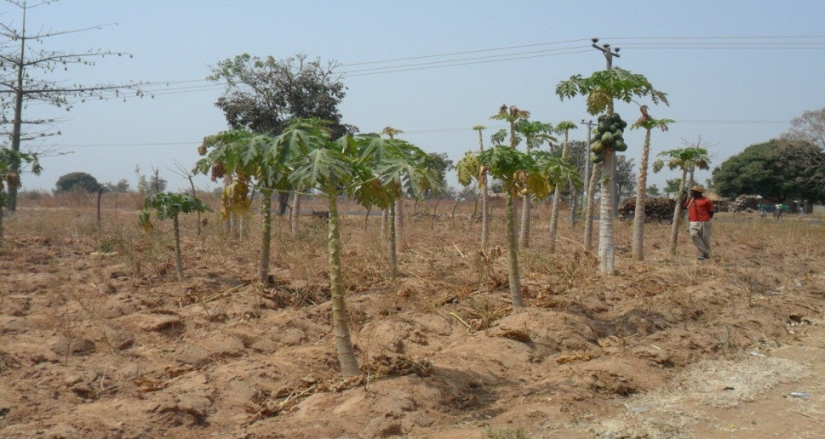
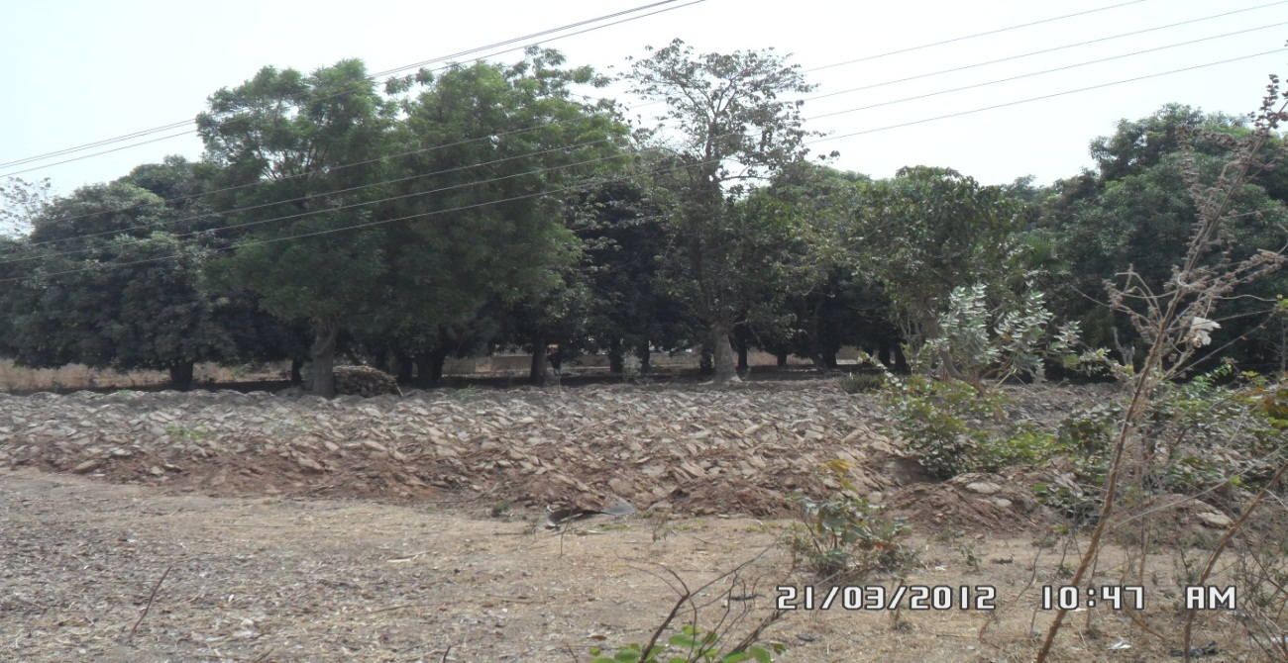
Plate IX: Paw-paw as additional crop after harvesting main crops
Plate X: Yam heaps and ridges awaiting the rain.
Plate IX
Plate X

Slide 17
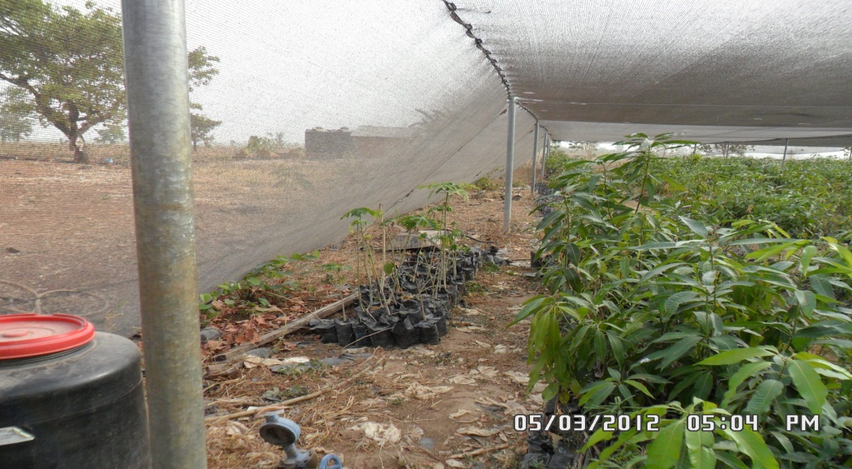
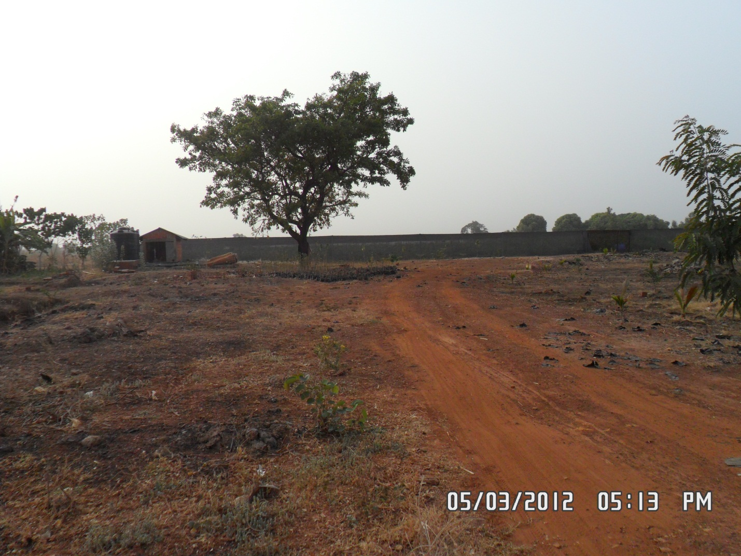
Plate XI: Hybrid seedling production for sale
Plate XII: Water bore hole for irrigating farms and nurseries
Plate XI
Plate XII

Slide 18
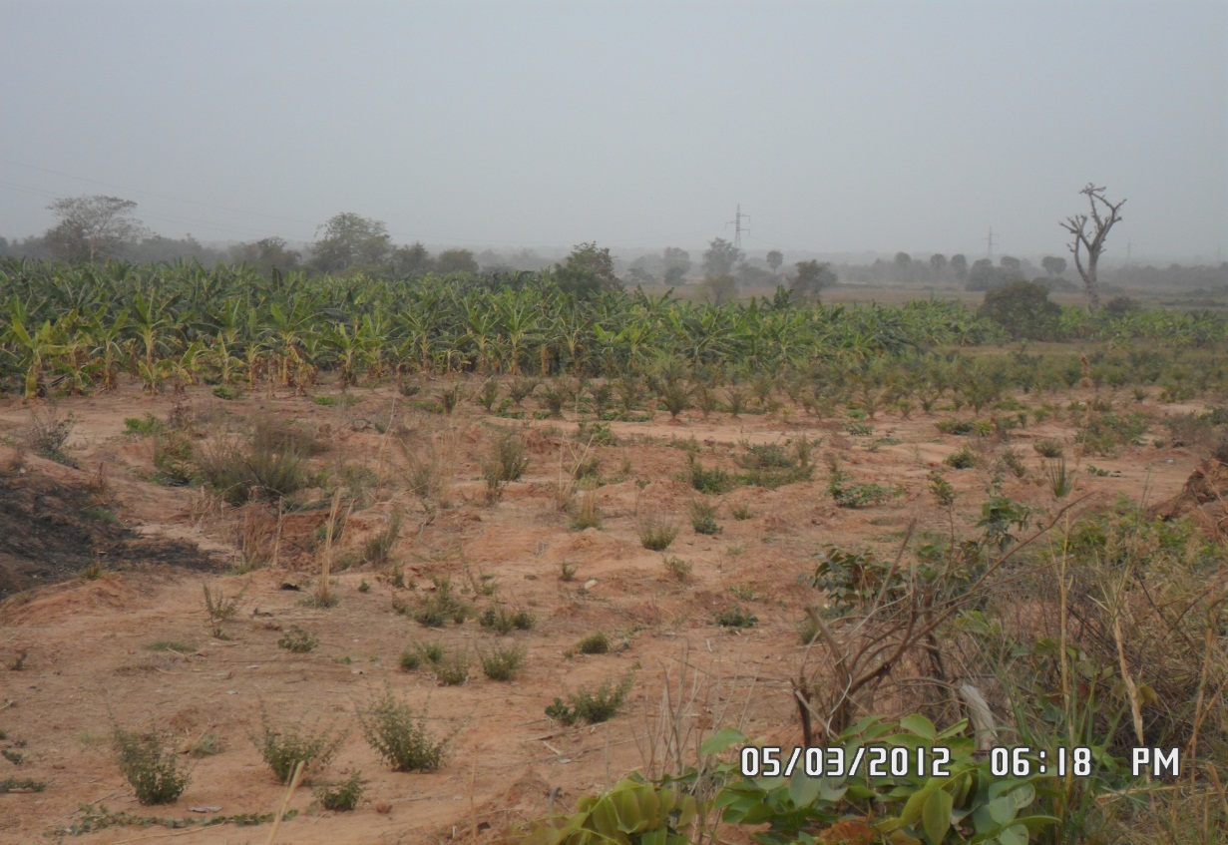
Plate XIII: Banana and palm plantation on a redeemed land

Slide 19
Dandume: Increased farm inputs, excess rains and community efforts
Use of technology: with increase access to technology, there is increased production.
Availability of fertilizers and farm chemicals
Annexing excess rainfall: farmers plant varieties of cowpea (beans and soy beans) to take advantage of the soil moisture.
Public participation: Farmers with regular employment and are ‘bankable’ farmers and formed cooperative societies.

Slide 20
Problems confronting farming innovations
Lack of stable market: affecting power to bargain for better price.
Unstable prices: lacking the control of market mechanisms; a bag of tomatoes can go for N2,000.00 ($12.5) during the rainy season, but is sold for only N300 ($1.87) during main harvest periods.
Double taxation, on farmers who leave in one administrative unit, farm or work in another and also goes to market in another zone.
Lack of access to farm implements.
Lack of adequate storage facilities.
Uncontrolled intrusions: uncontrolled housing.
Lack of adequate protection by law: Zaria and similar traditional cities in Nigeria are not subjected to modern planning regulations. No legal code local standards or their contraventions.
Unmanaged municipal wastes: residents dump waste at any given space.

Slide 21
Conclusion
Both rural and urban authorities need to wake up to the challenges of the present issues of climate change and food security. If the various ways devised by these majority peasant farmers, apparently un-aided, are given priority, then; it can be said that even in the face of climate change there is still more opportunities for agricultural production in Savanna regions than ever before.

Slide 22
Recommendations
  Recognizing and protecting their right to farmlands through adequate protection from land speculators.
  Ensuring that areas with such innovative practices are mapped and given the status of protected land.
  Differentiate them from large scale farmers and commercial horticulturists who contrary to peasant farmers usually demand large consignments of farm inputs.
  The extension of fruitful adaptation practices to other parts of Nigeria and the entire sub-Saharan region is likely to receive warm reception, but if it is capital-intensive, very few will be willing to invest in it.
  There should be the establishment of extension works and demonstration farms to propagate these innovative practices.
  Government institutions –can imbibe the practice of giving out vacant lands for cultivate instead of allowing them to perpetually lie fallow.

Slide 23
REFERENCES
Kawu, A. M. (2005). Development Control in Traditional Settlements: A Case Study of Zaria City. Unpublished MSc (URP) Thesis, Ahmadu Bello University, Zaria.
Schwerdtfeger, F. W. (1980). Traditional Housing in African Cities: A Comparative Study of Houses in Zaria, Ibadan, and Marrakech. Hampshire: John Wiley & Sons Ltd.
Udo, R. K. (1980). Geographical Regions of Nigeria. Ibadan: Heinemann Education Books.
Urquhart, A. W. (1977). Planned Urban Landscape of Northern Nigeria. Zaria: Ahmadu Bello University Press.
Googlearth, (2012). Minna and Zaria Images. A Satellite Image, accessed march 2011 from www.googlearth.com

